Slide 1
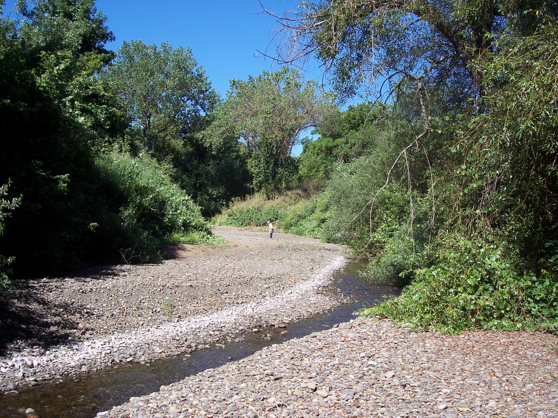
Conceptual Model of Stream Flow Processes for the Russian River Watershed

Slide 2
Conceptual Model of Stream Flow Processes for the Russian River Watershed
Several features of creeks affect the interactions between surface and groundwater.
This conceptual model uses the thickness and type of alluvial deposit and the degree of natural channel confinement to define surface and groundwater interactions.
The conceptual model analyzes these features and defines 8 channel types:
Colluvial channels
Bedrock canyon channels
Confined alluvial channels
Semiconfined alluvial channels
Dissected alluvium channels
Alluvial fan channels
Unconfined alluvial channels
Regulated river channel
The conceptual model was applied to the fish-bearing creeks in 8 subareas of the Russian River basin.
The channel typology was developed by Scott Walls as part of his master thesis under the guidance of Dr. Kondolf and the ISRP.

Slide 3
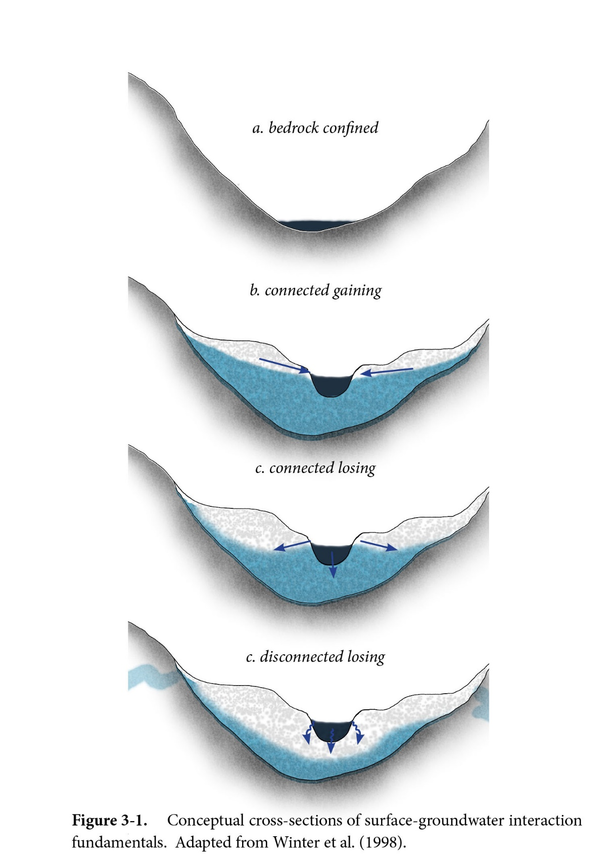
Bedrock channel (a) and alluvial channels (b-d) depicting surface and groundwater interactions of gaining and loosing.
d

Slide 4
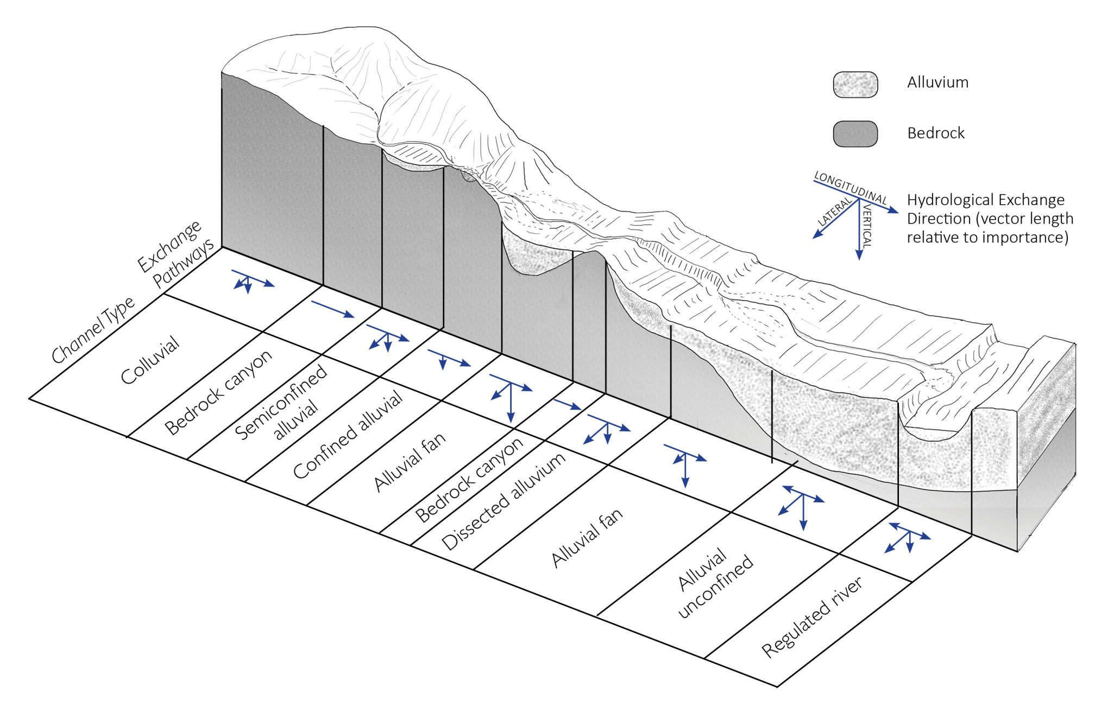
Conceptual model of stream flow processes
This figure shows a cross section through the watershed and defines the 8 channel types in their typical locations in the drainage. The arrows show hydrological exchange.

Slide 5
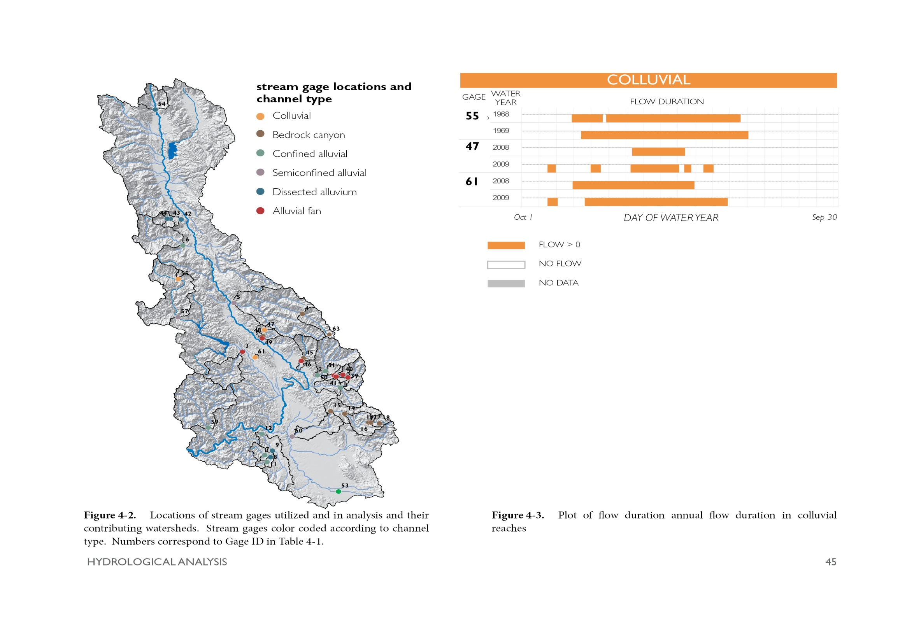
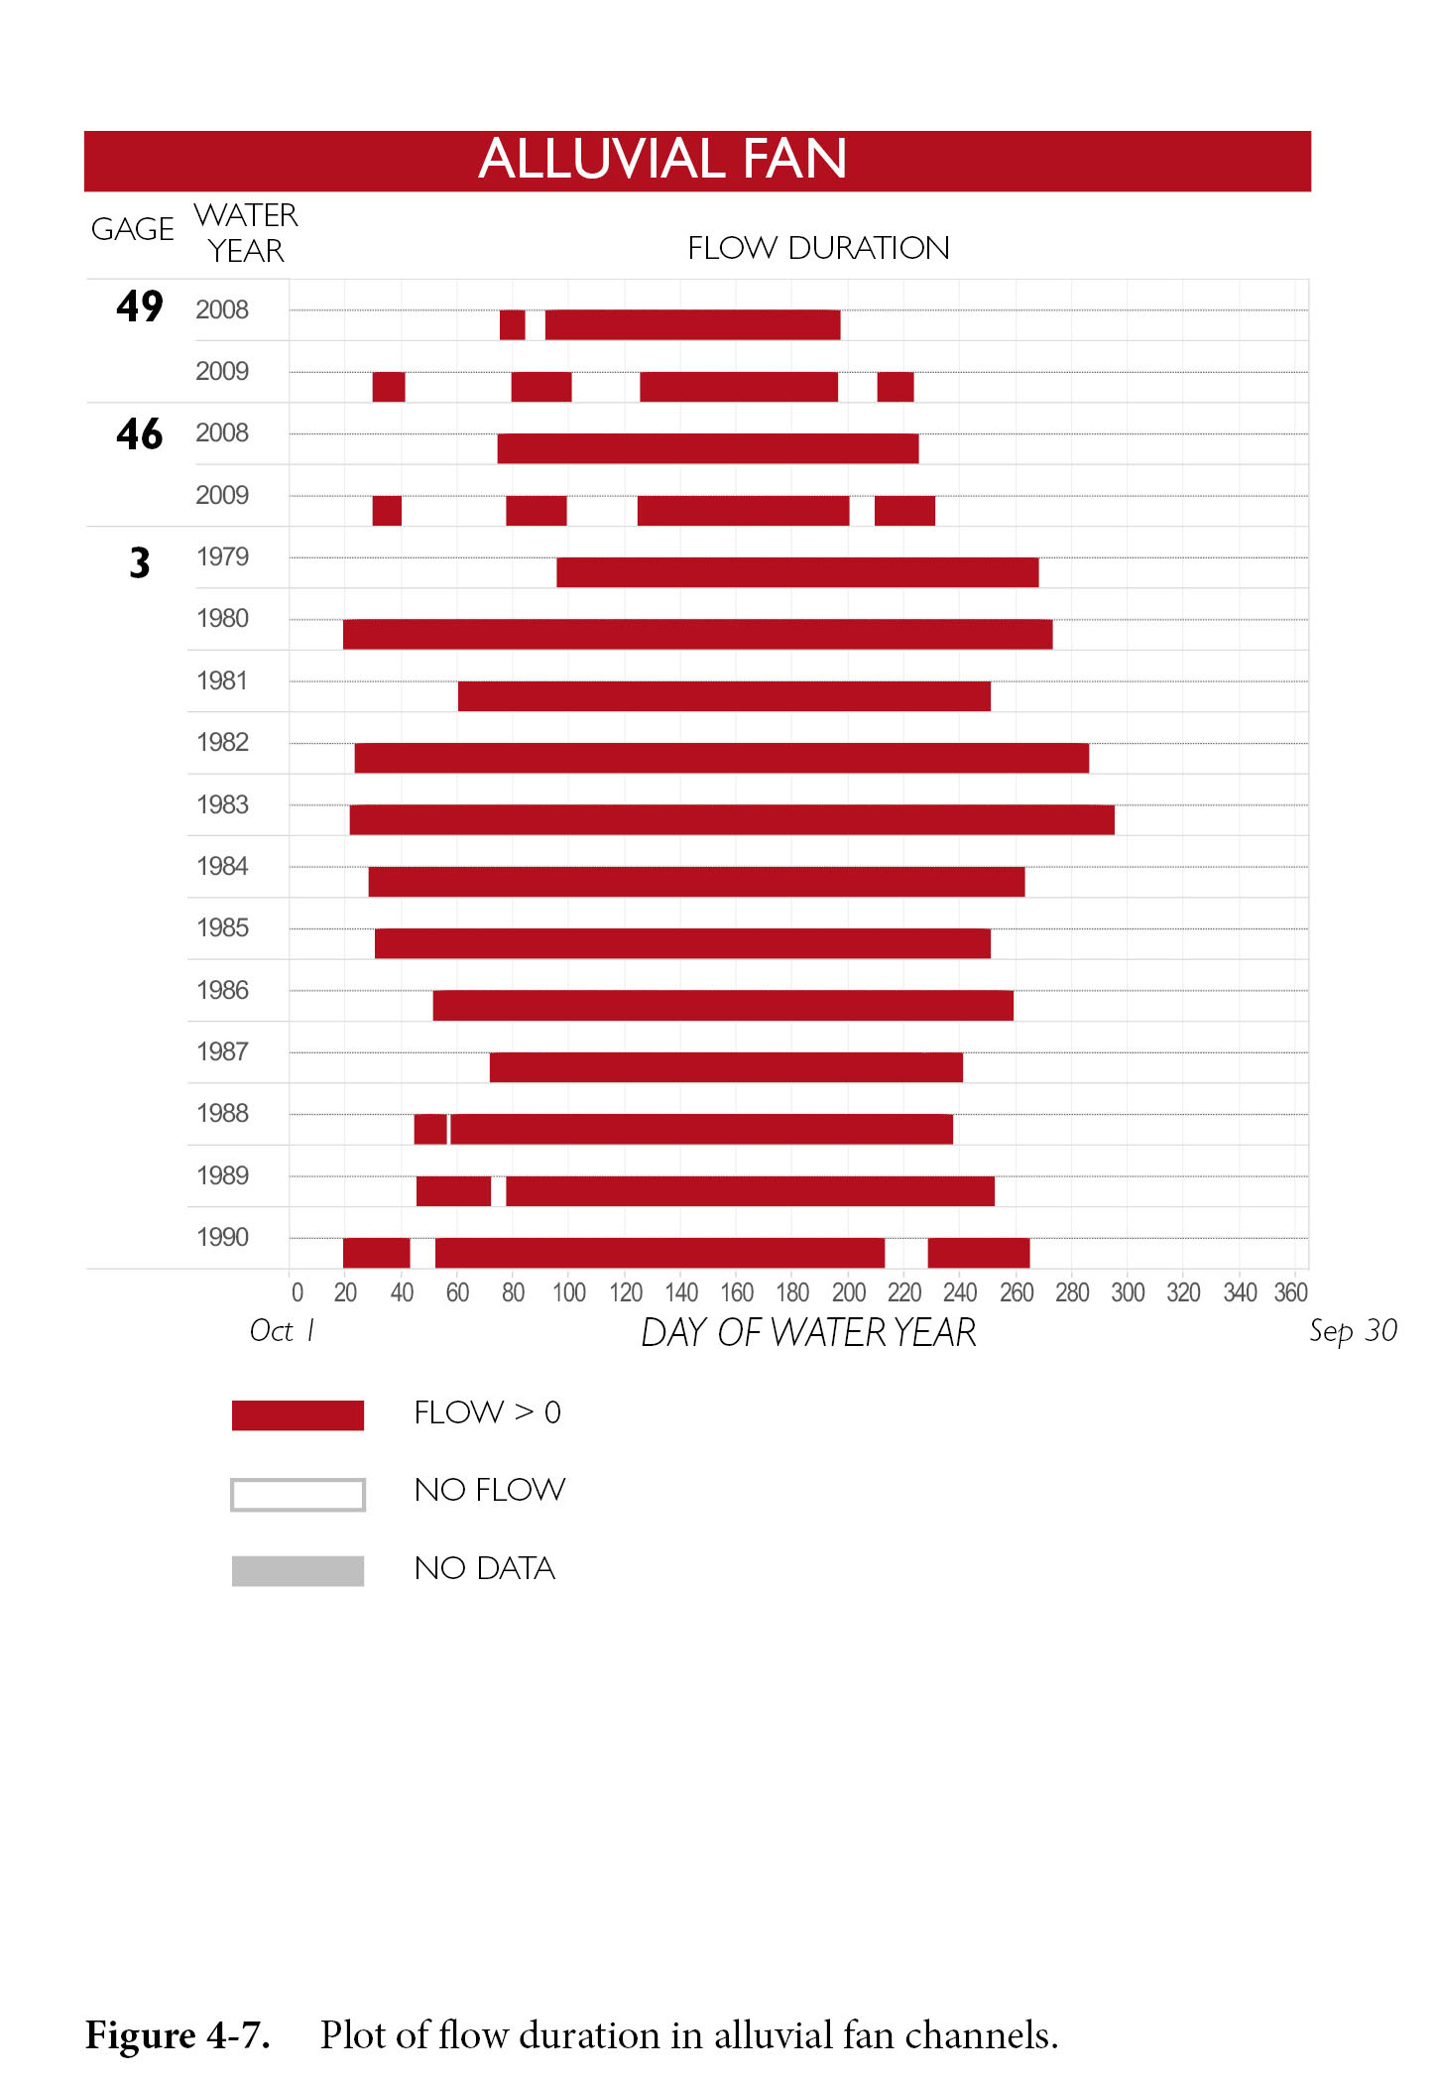
Gill Creek
Sausal
Creek
Pena Creek
Data from 40 stream flow gages including various channel types were analyzed to evaluate the seasonality of flow. Gages in alluvial fan channel show intermittent flows.

Slide 6
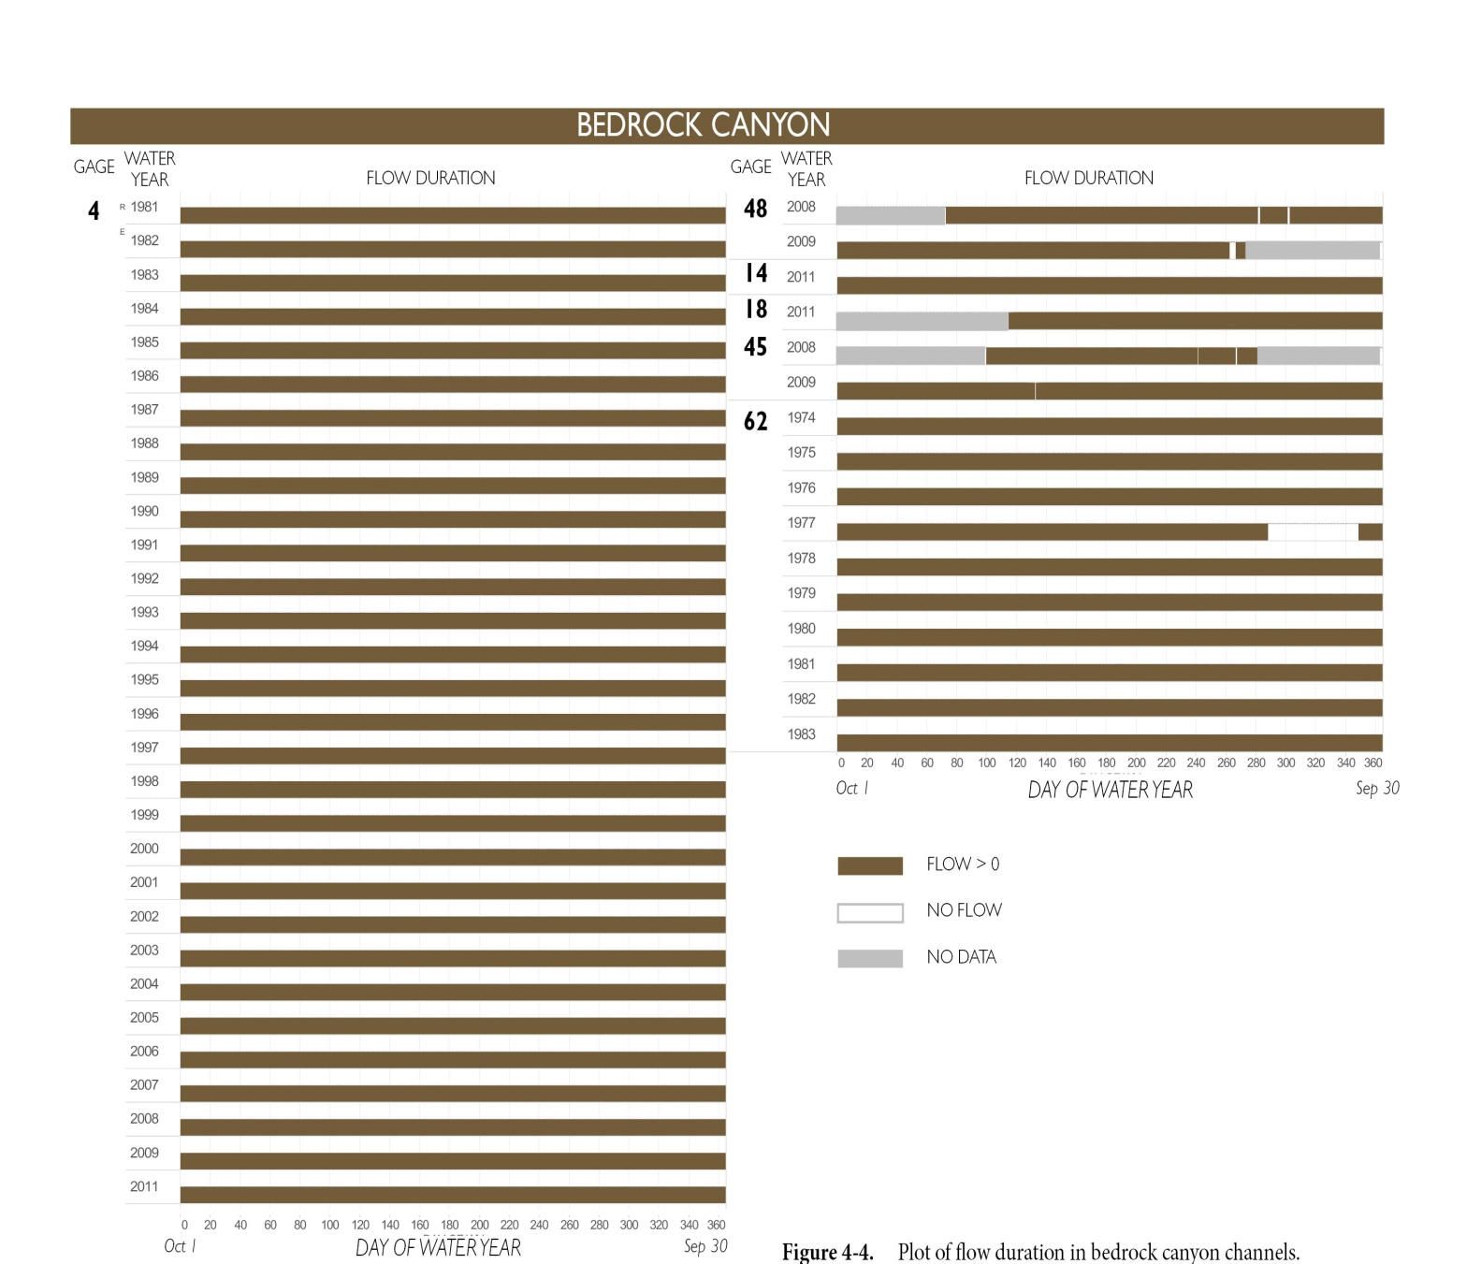
Big Sulphur
Gill Creek
Mark West
Sausal Creek
Warm Springs
Stream flow gaging data for Bedrock Channels shows year round flows in most years

Slide 7
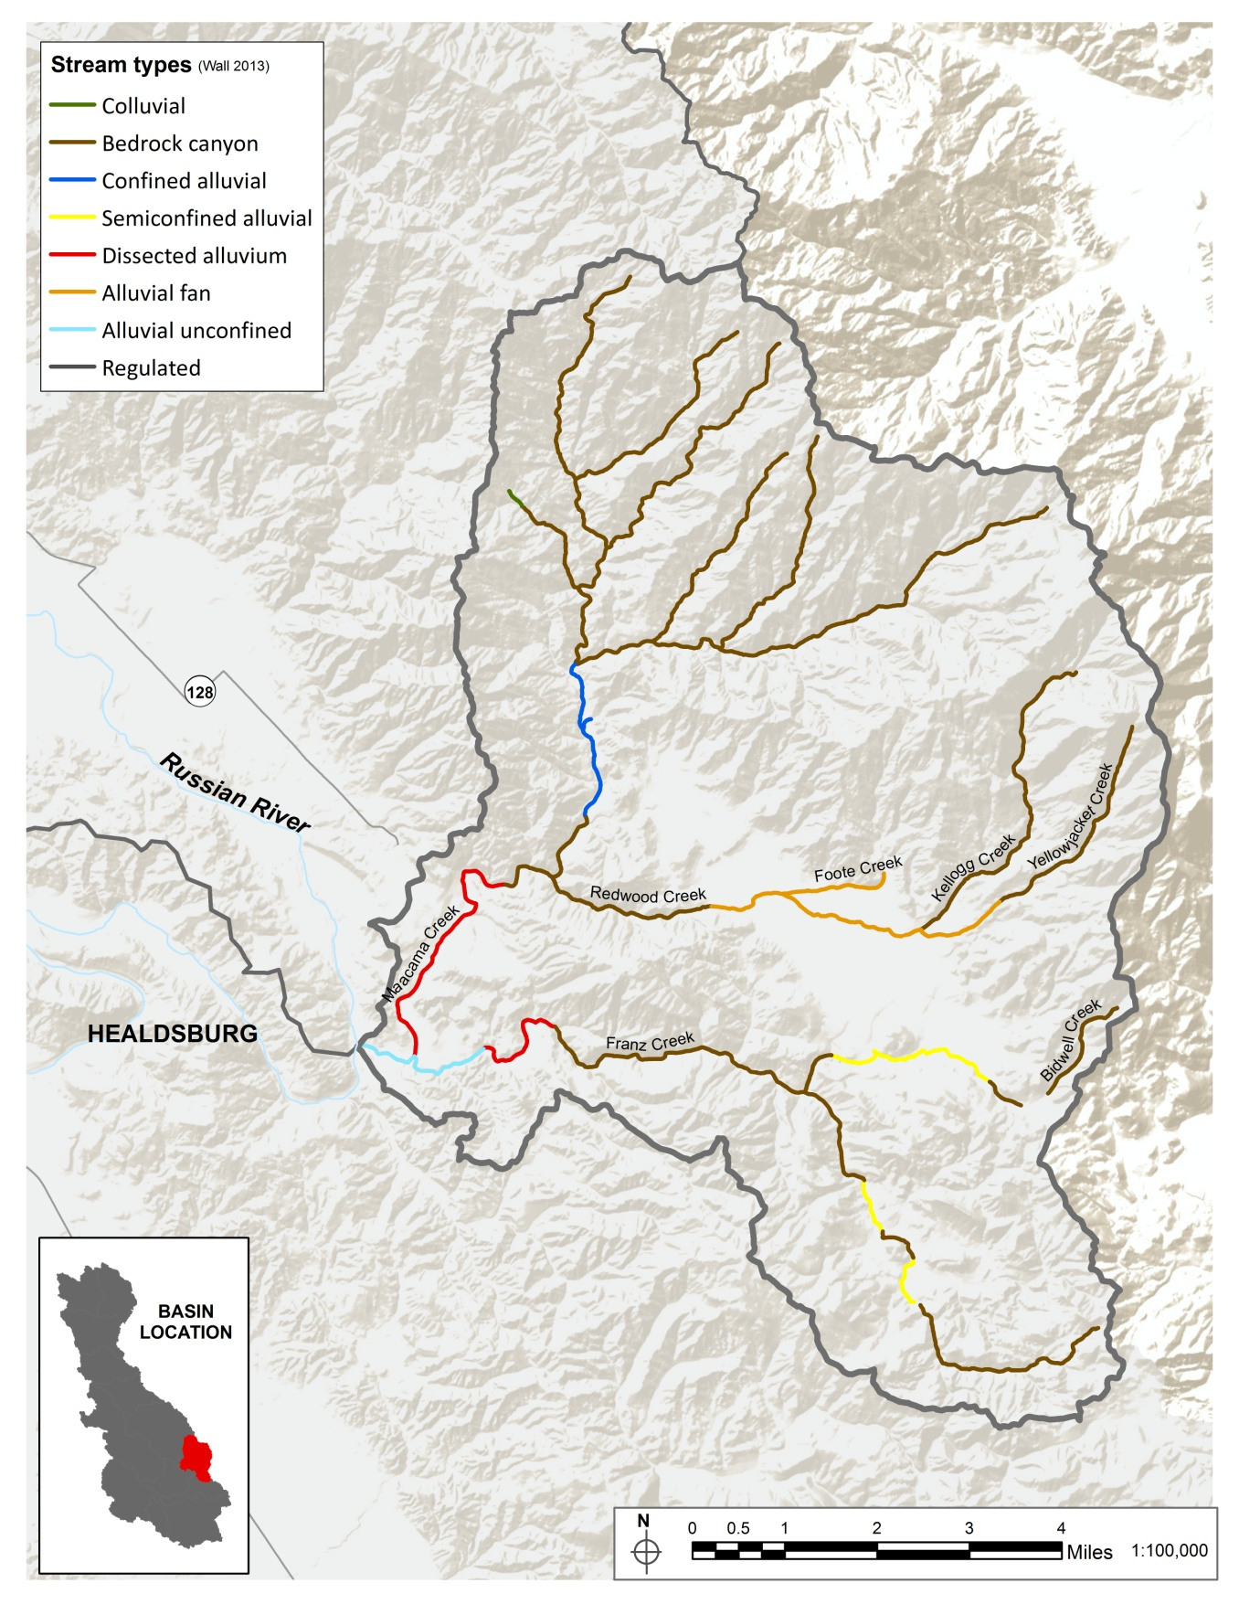
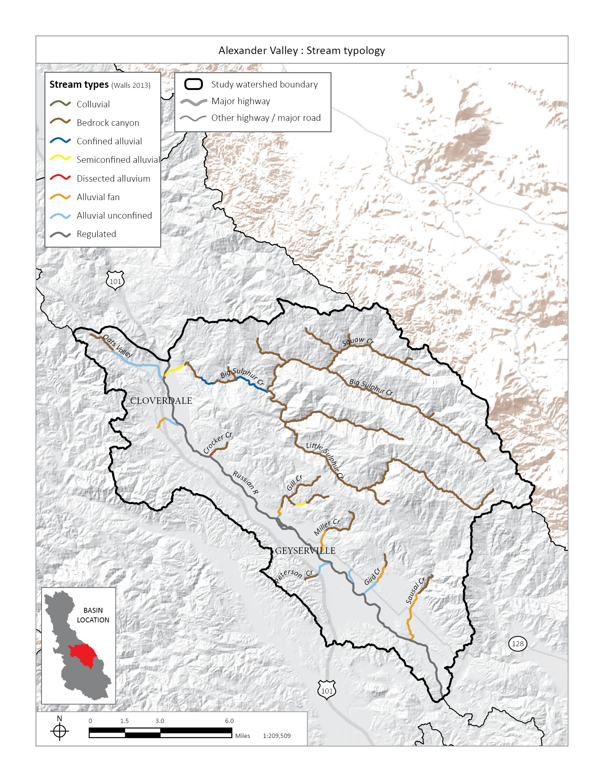
Channel typology for the Knights Valley subarea shows six channel types
Watershed Boundary

Slide 8
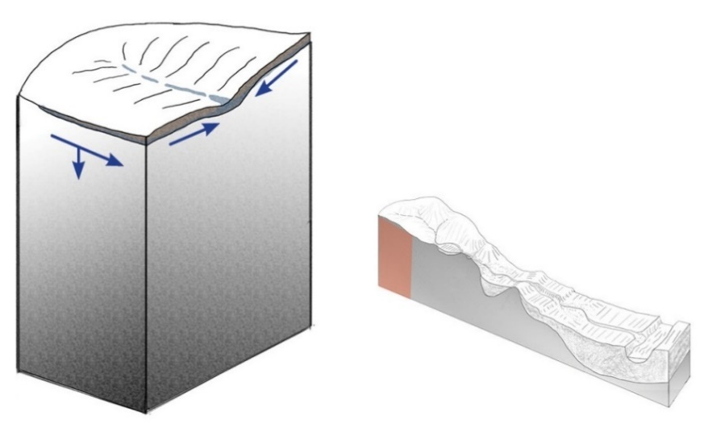
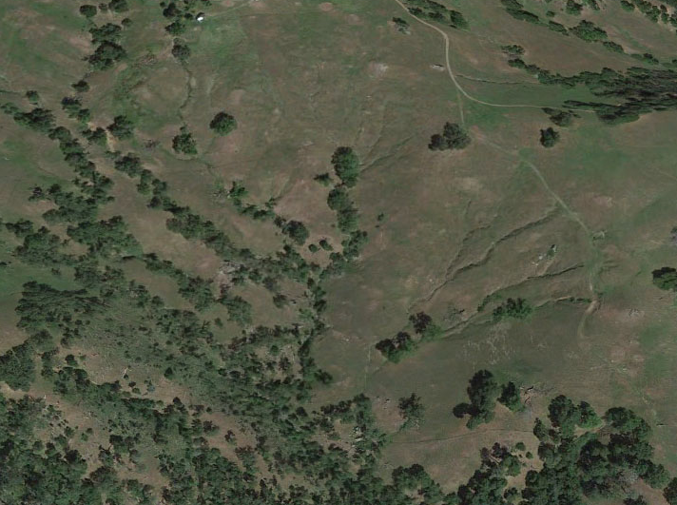
Colluvial Channel
High slope >8% headwater streams
Flow through unconsolidated hillslope material or colluvium
Flows are intermittent
These channels make up 50-80% of drainage networks and make significant contribution to downstream flow
Don’t support salmonid habitats except in a few locations but support macroinvertebrates and amphibians
May have on-stream reservoirs

Slide 9
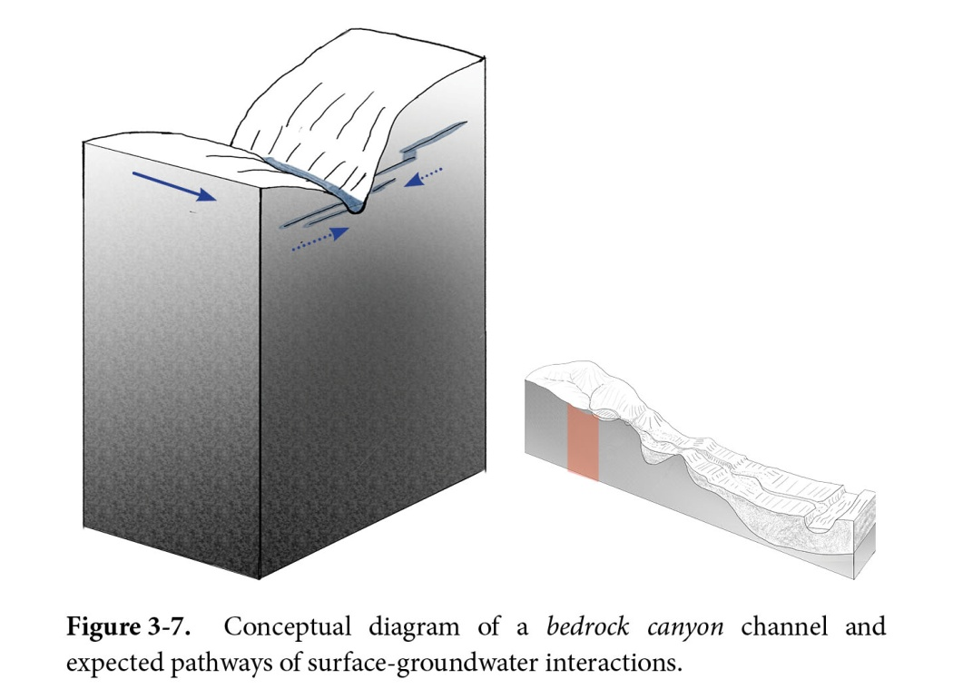
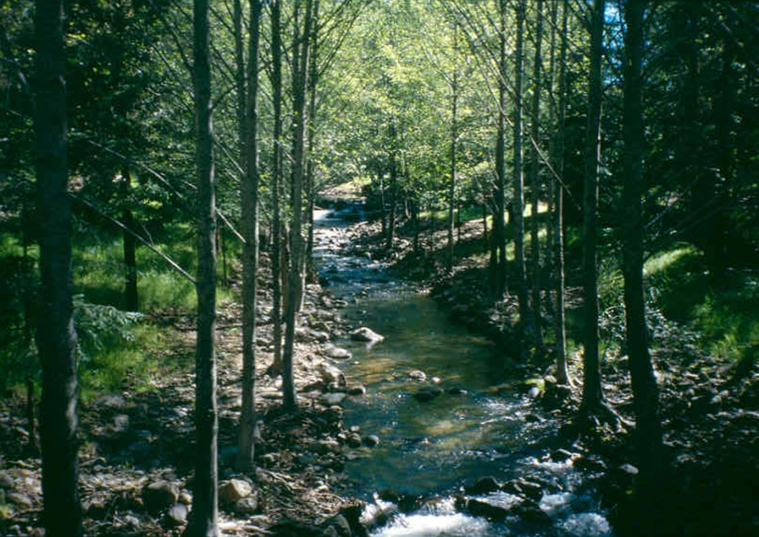
Bedrock Channel
High channel slope 1-8%
Creek is confined by canyon walls
No floodplains and little alluvium
Year round flow
Bedrock relatively impermeable, water does not infiltrate
Cracks and fissures in bedrock can deliver water into creek
Affected by direct diversions,
wells in certain types of bedrock
Most likely channels for summer rearing by steelhead

Slide 10
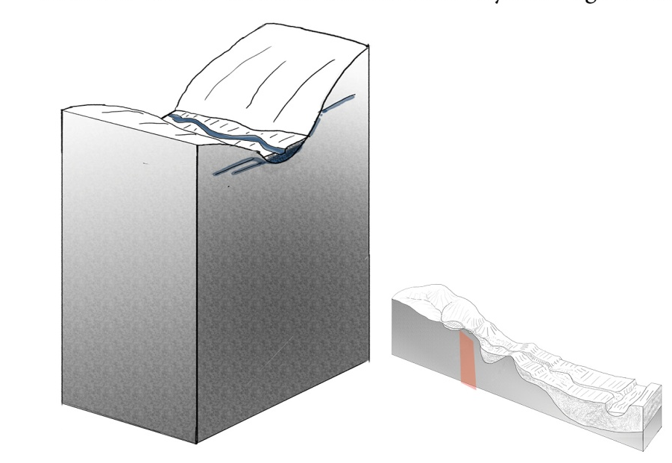
Confined Alluvial Channel
Channel slope is 1-4% with confining walls
There are gravel bars but no floodplains
Channel will have pool and riffle morphology Stream flow gaging shows year round flow in most locations but also summer dry conditions
Rural residential uses may border creek
Wells need to be screened in the underlying bedrock not the alluvium
Adjacent roads can channelize the creek and remove riparian and aquatic habitats
May support salmonid spawning and winter rearing with fish moving to bedrock channels for summer rearing

Slide 11
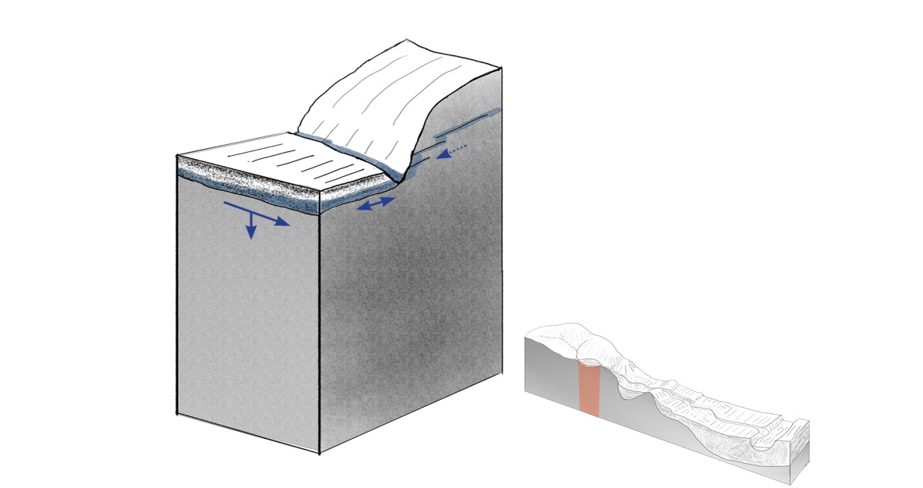
Semiconfined Alluvial Channel
Channel slopes are 1-4%
Channel has floodplains, gravel bars, riffles and pools
One bank is constrained by valley wall
Occur where pull-apart activity has occurred
May have secondary channels, floodplain wetlands and sloughs
Stream flow gages show year round flow and some intermittent summer conditions
Both agriculture and/or rural residential land uses may border channel
Shallow wells and direct diversions can affect flow
May support salmonid spawning and winter rearing with fish moving to bedrock channels for summer rearing

Slide 12
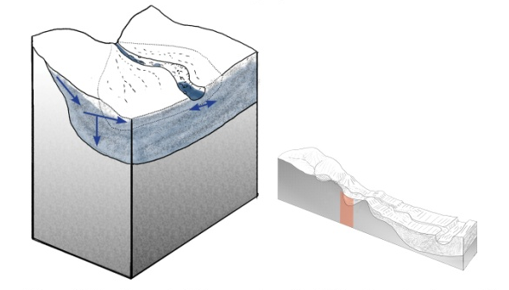
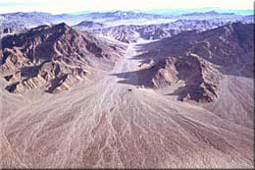
Alluvial Fan Channel
Channel slope 2-4%
Cone or fan-shaped, unconfined alluvial deposit
Form at transition between high slope bedrock channel and flat valley floor
Braided and multi-channeled system with channels migrating across fan in flood events
Water infiltrates at head of fan, may have lakes or wetlands at end of fan
Intermittent flow, may dry between winter storms
Agriculture on fan usually manages fan to have one channel
Does not support salmonid habitats
May be a barrier to salmonid migrations between river and bedrock creeks

Slide 13
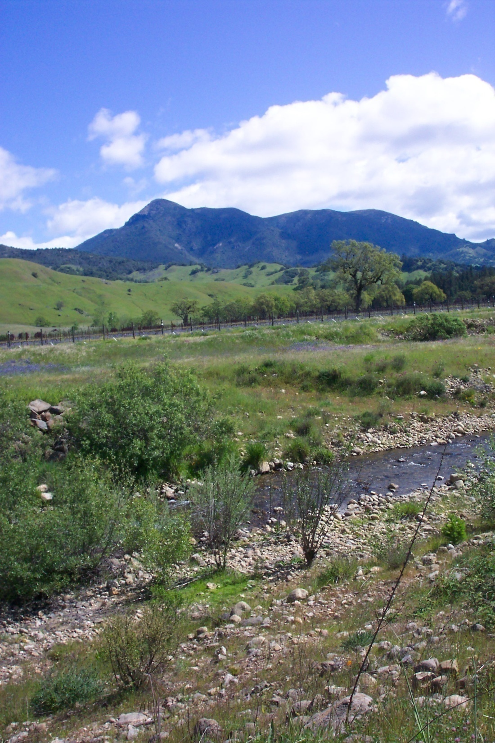
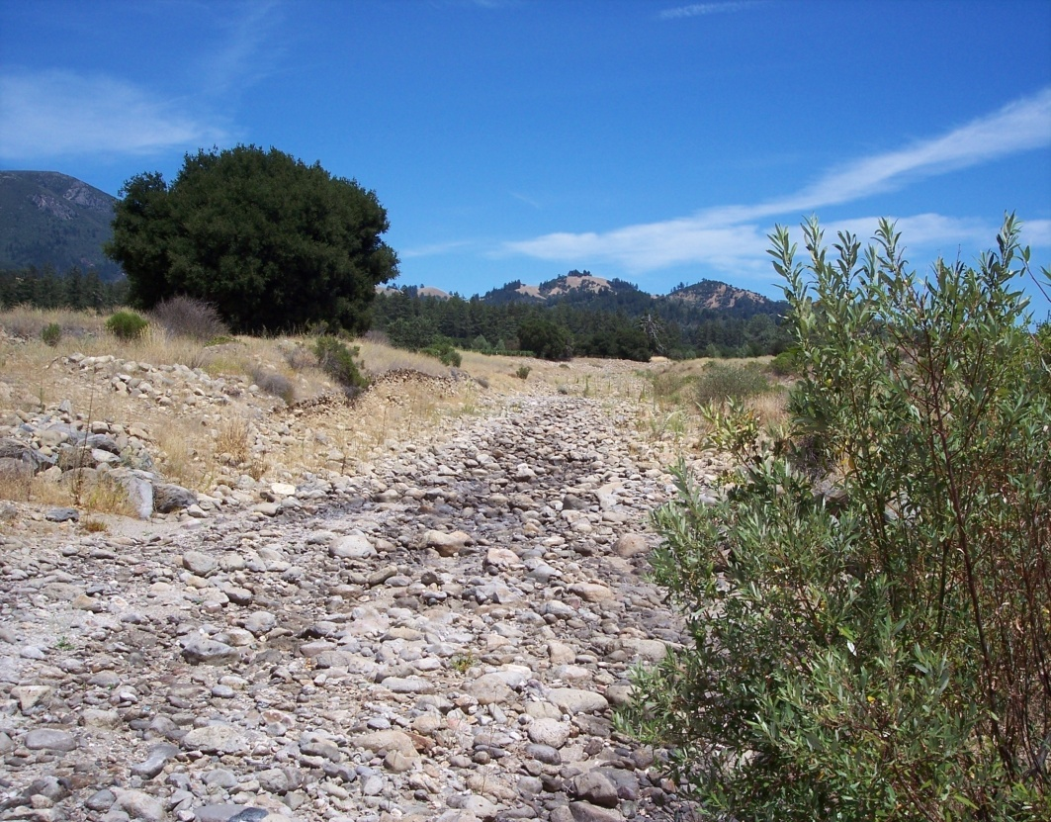
Alluvial fan channel has intermittent flows in winter and dry conditions in summer

Slide 14
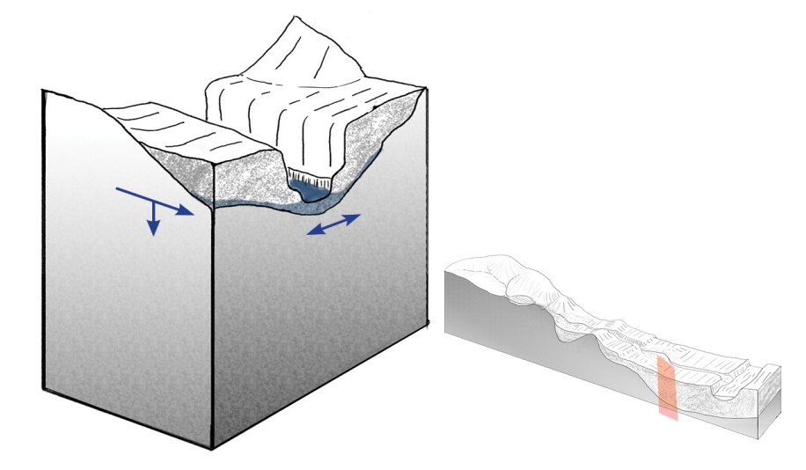
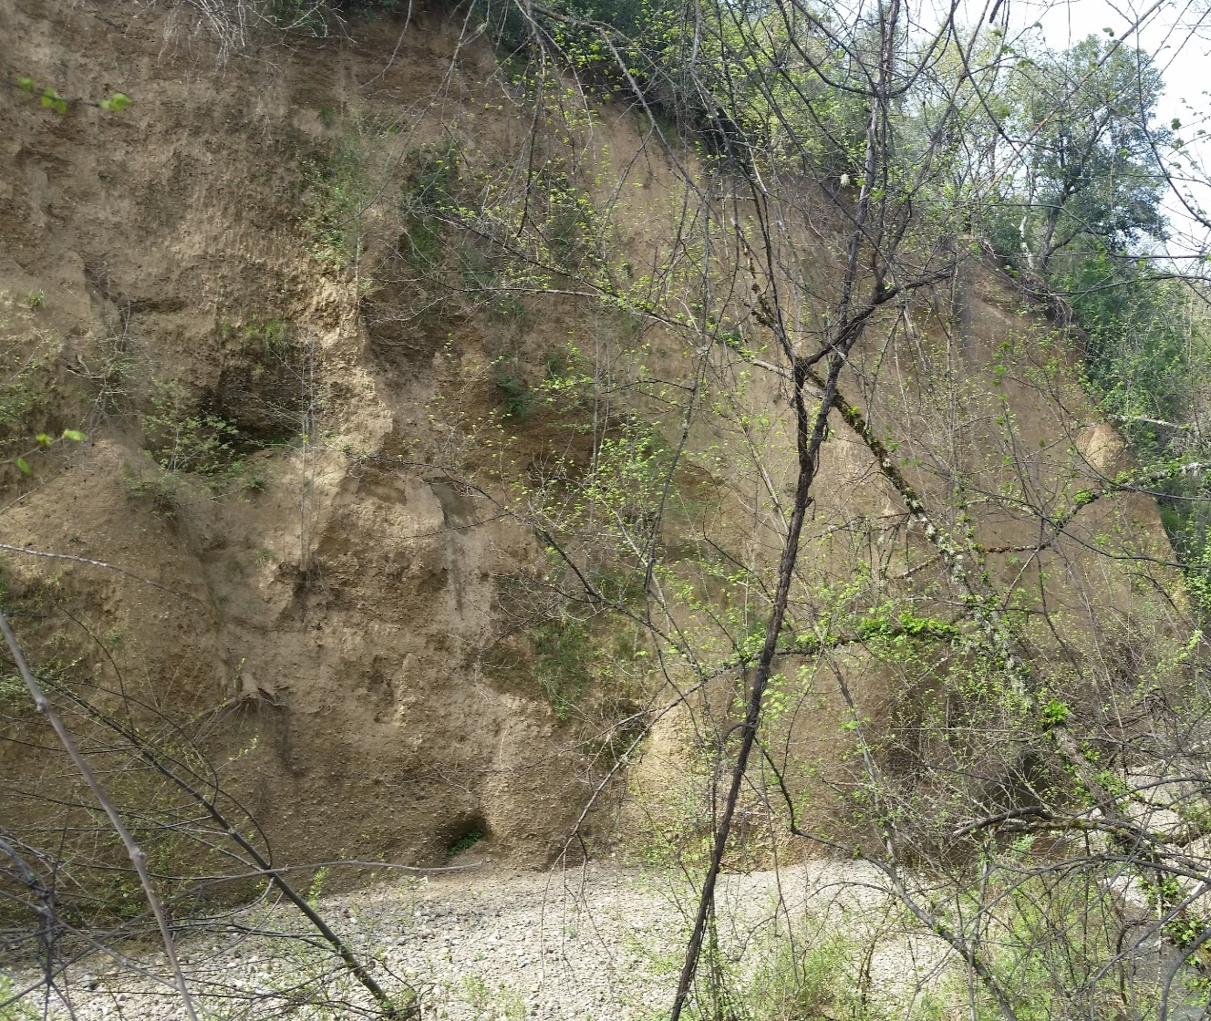
Dissected Alluvium
Channel
Channel slope 1-4%
Older Pleistocene-era alluvium was deposited into pull-apart basins then uplifted
Limited in distribution, alluvium is high in clay so banks are tall and more competent than younger alluvium
Year round flow to intermittent, summer dry conditions
Agricultural and/or rural residential uses border these channels. Wells are low production only used by houses
Salmonids may spawn and rear if flow is adequate
On-stream reservoirs and direct diversions affect flow

Slide 15
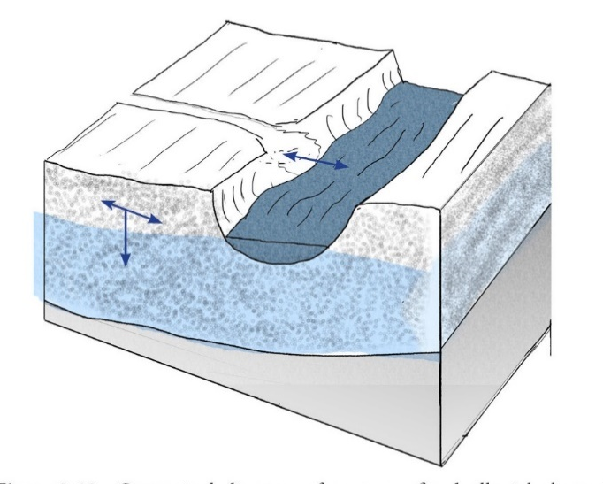
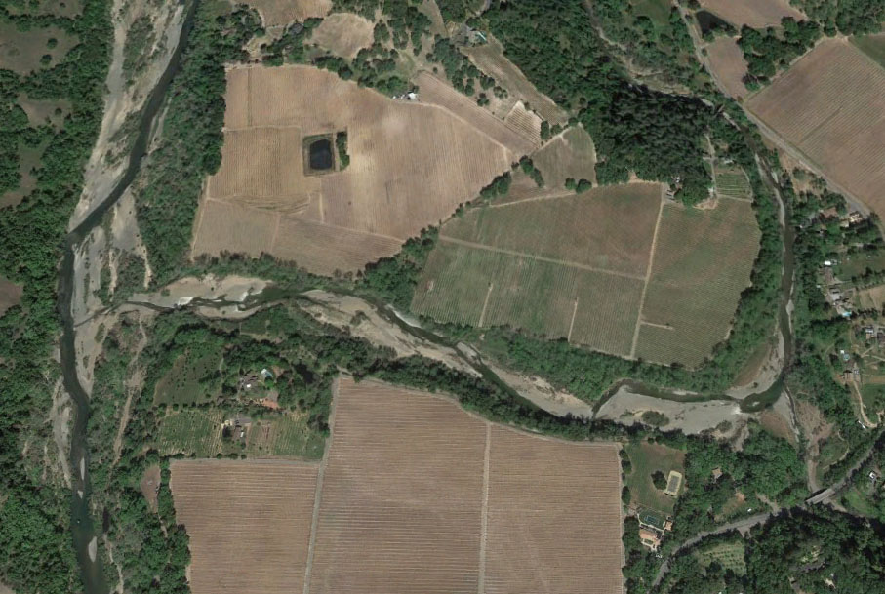
Channel slope <1%
Primarily occur on valley floor
No confinement by hillslopes
Channels meandered and had floodplains (valley floor), very low to no flow historically
Entrenchment of river channel lowered groundwater table in valley and makes these channels dry in summer and between storms
Most highly modified – channelized by agriculture and put in pipes for urban
Used as migratory streams by salmonids
With flows going subterranean to meet river stage in entrenched channel, fish may be stranded or unable to migrate
Unconfined Alluvial
Channel
Maacama Creek
Russian River

Slide 16
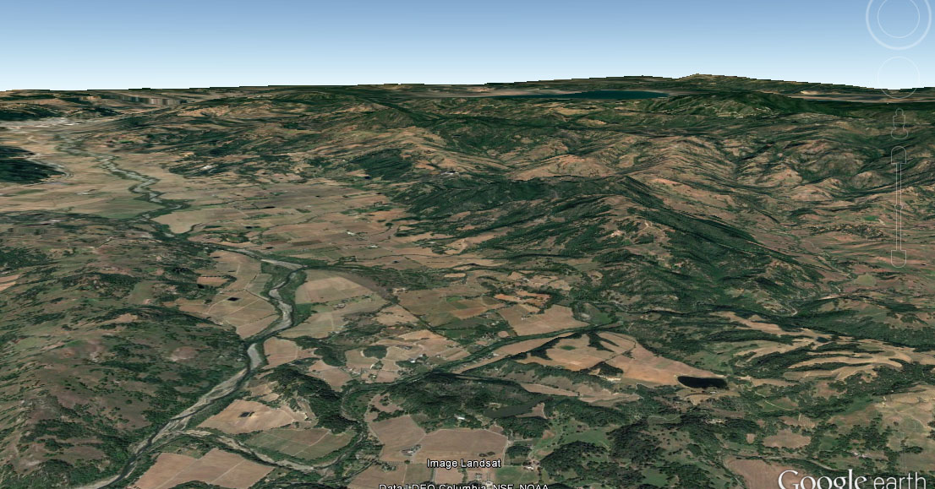
Regulated River
Russian River
Maacama Creek
Main stem river is an unconfined alluvial channel of <1% slope in valleys with steeper bedrock channel between valleys
Flow is regulated by Coyote Dam to have higher flows in the dry season and lower flows in the winter
Channel was wide and shallow historically and now is highly entrenched and narrow, disconnected from its floodplain with a lowered groundwater table

Slide 17
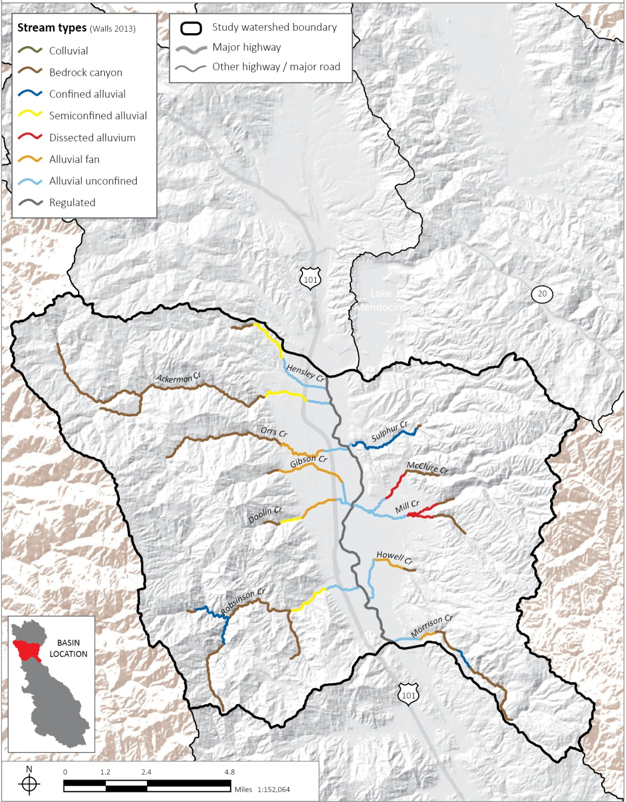
Ukiah Valley subarea
Ukiah
Morrison Creek

Slide 18
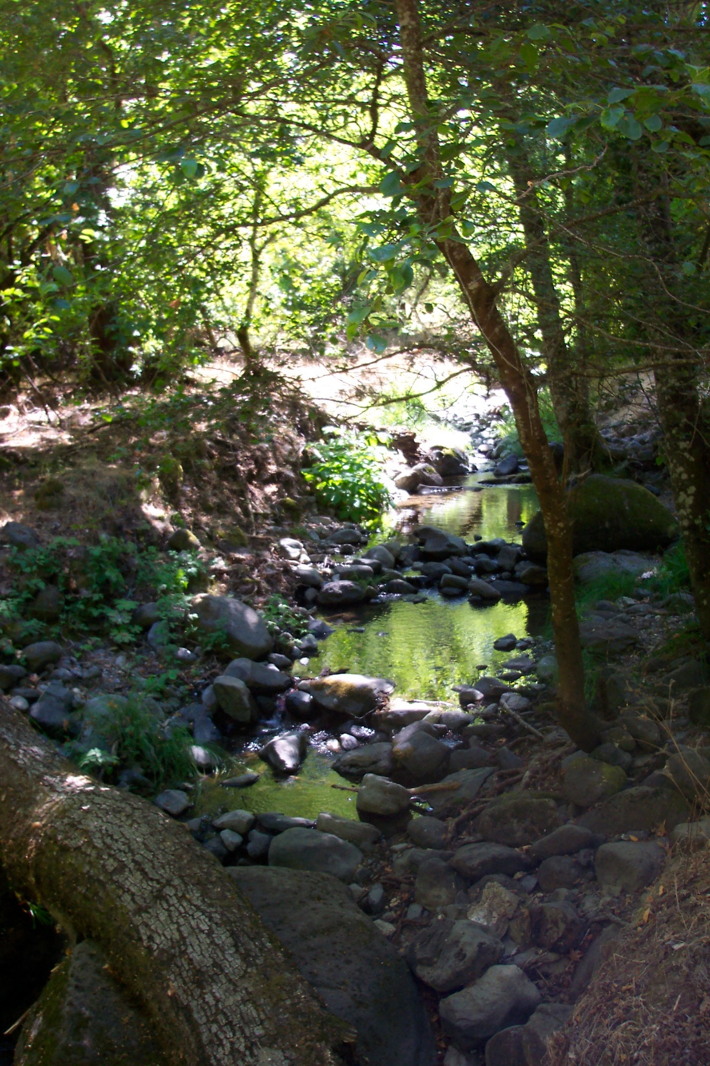
Morrison Creek bedrock channel in summer

Slide 19
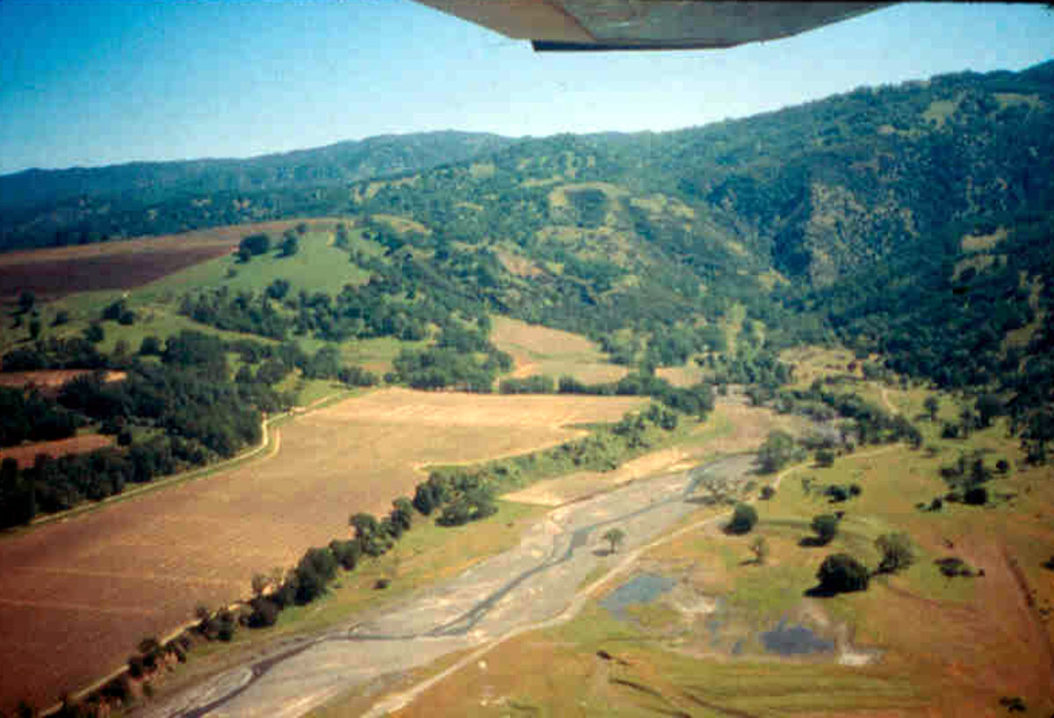
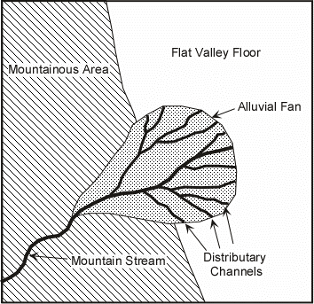
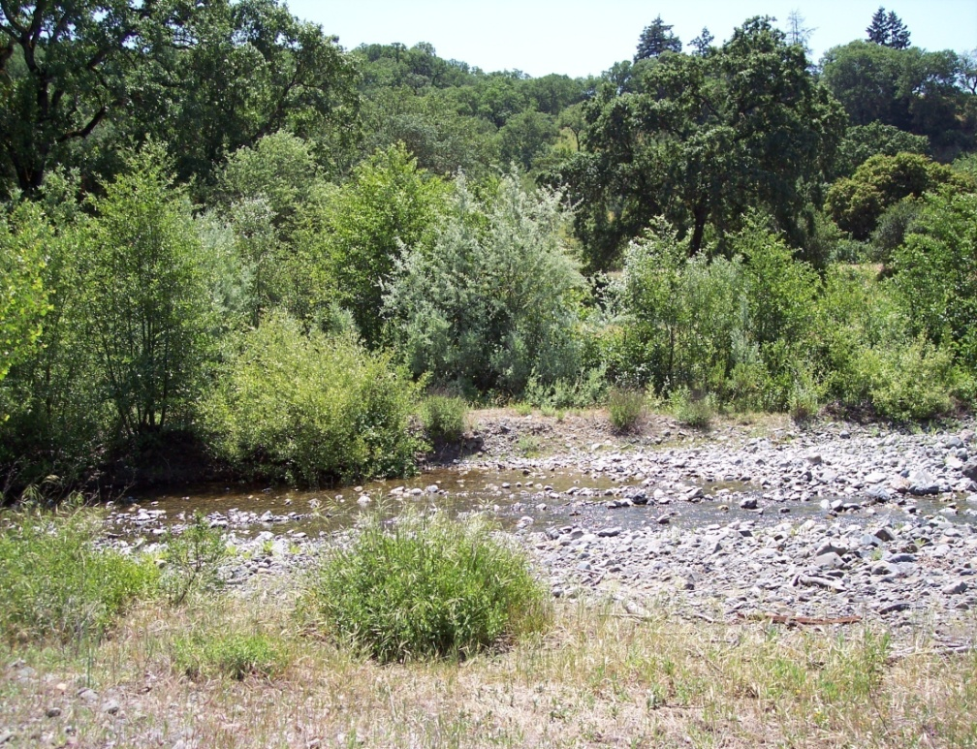
Alluvial fan channel in Morrison Creek watershed
Stream flow infiltrating into alluvium on alluvial fan in Morrison Creek watershed

Slide 20
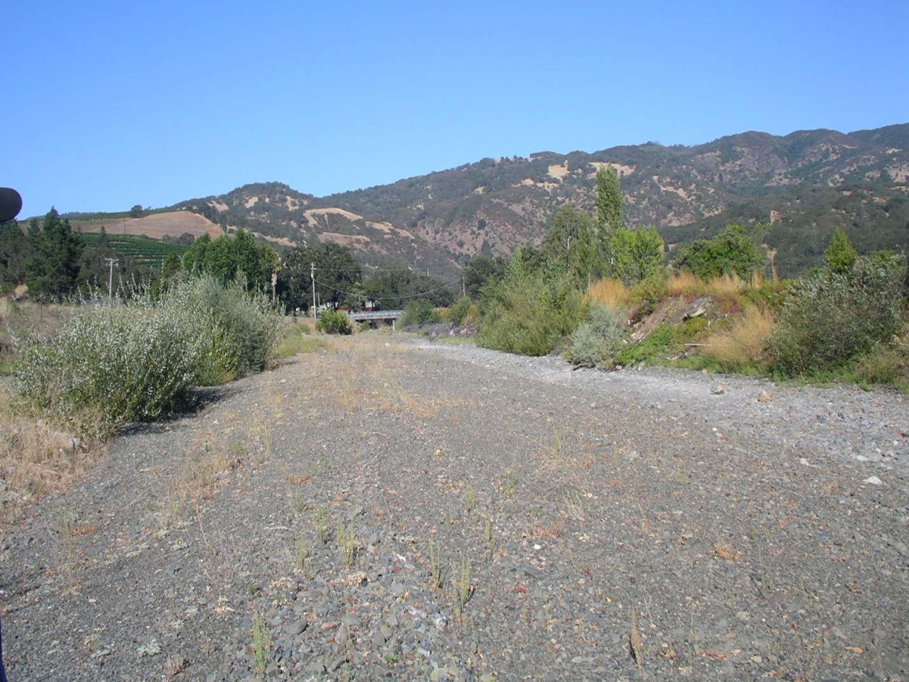

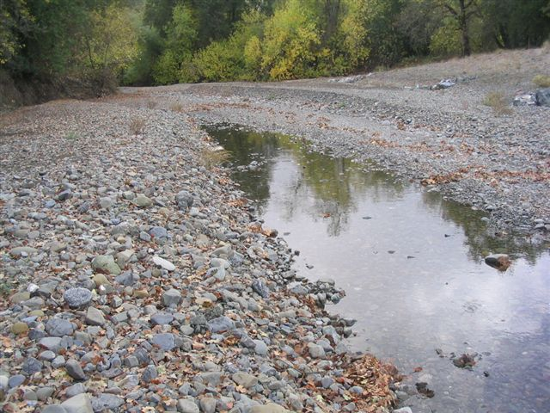
Russian River
Alluvial fan/Unconfined alluvial channel Morrison Creek watershed
Stream flow going subterranean into alluvium. Arrow shows direction of flow. River stage is low

Slide 21
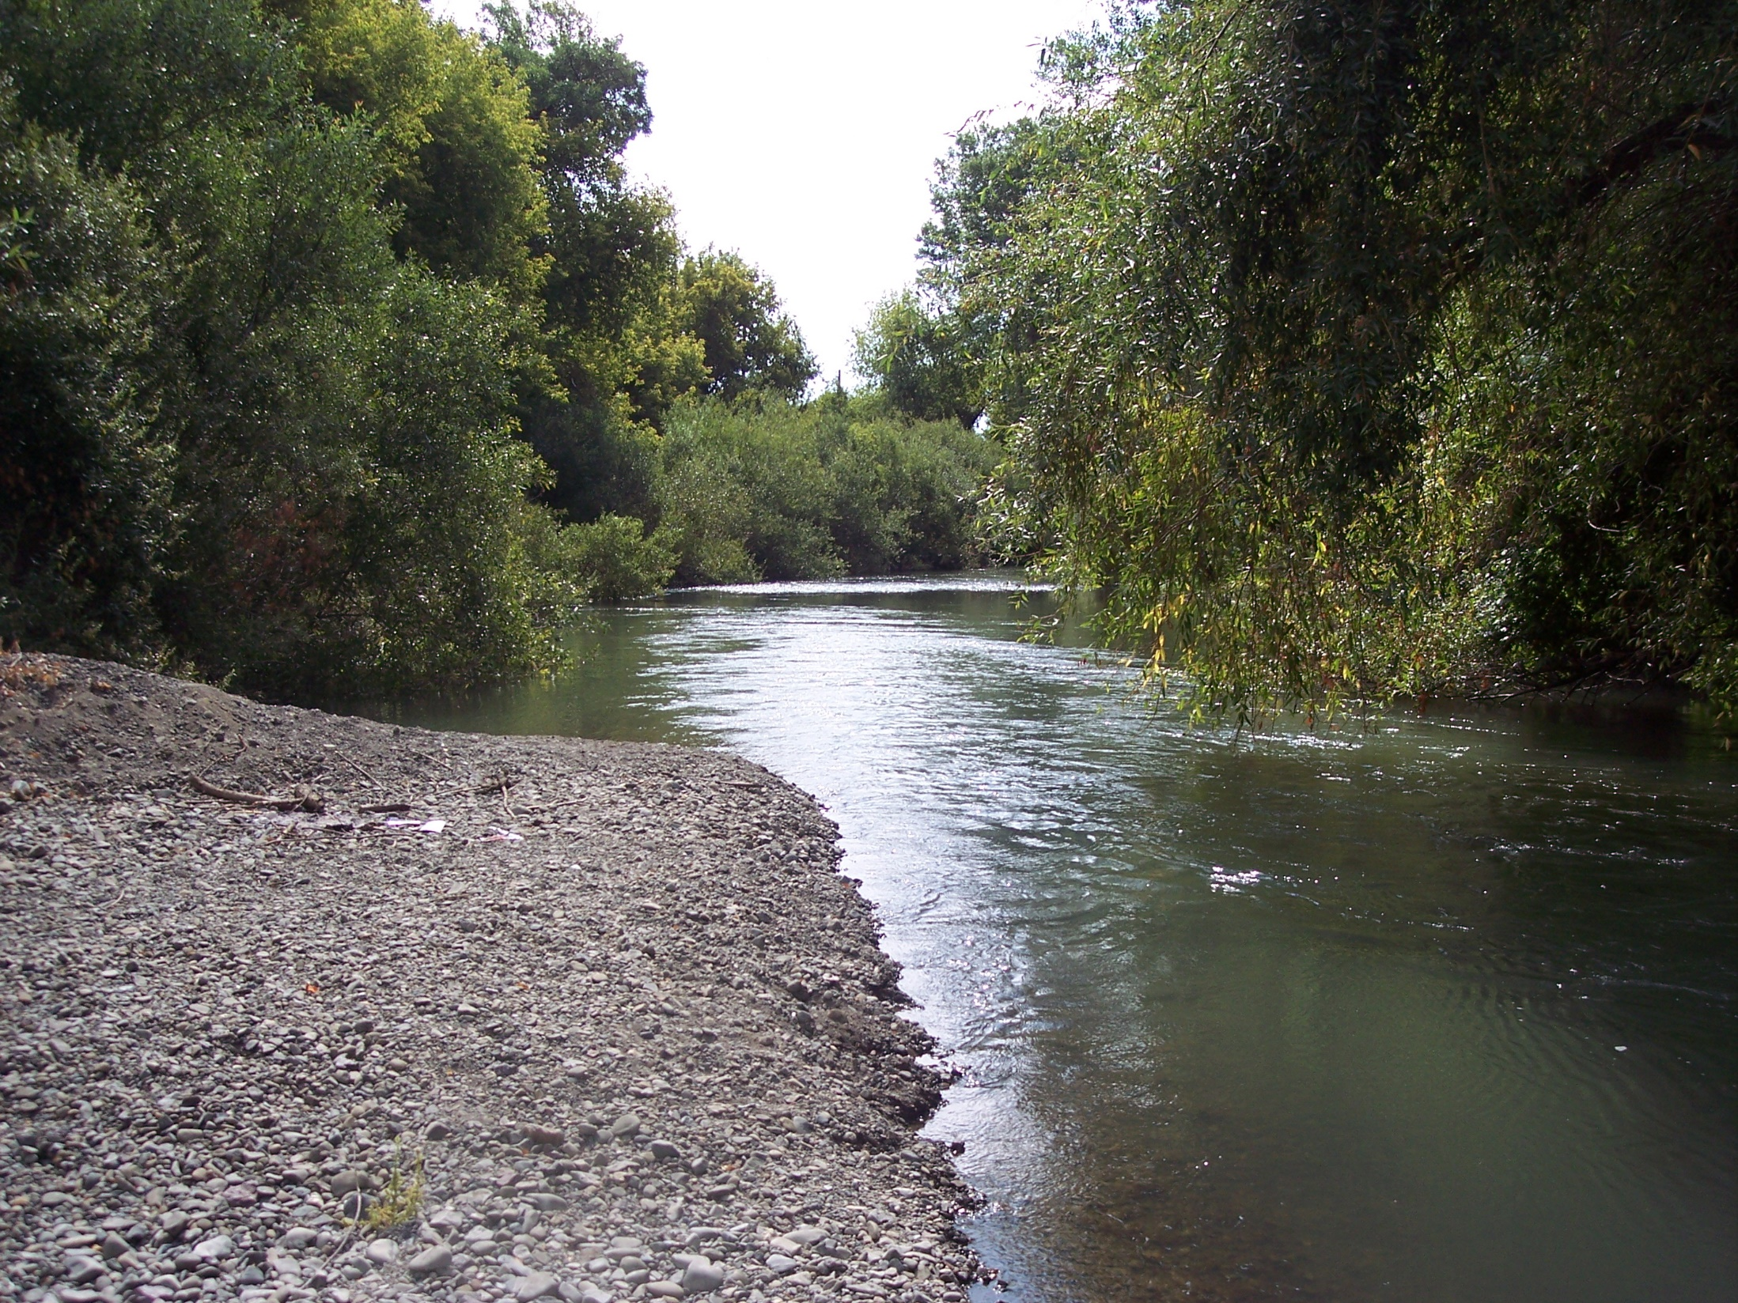
Delta of Morrison Creek at confluence with regulated Russian River channel

Slide 22
Channel Type | Size of Alluvial Deposit | Channel Slope Classes (%) | Months of Continuous Stream Flow | Water Temperature in Summer | Types of Human Use | Resiliency to Drought | Effects of Main Stem Stage Fluctuations | Vulnerability to Bank Erosion
Colluvial (COL) | none | >8 | <6 | Dry soon after rain. | On-stream dams | Dry most of the time--no resiliency | N/A | Low
Bedrock Canyon (BRK) | none | 0-1, 1-2, 2-4, 4-8, >8 | 12 | Cool when groundwater fed and has riparian canopy | On-stream dams, direct diversions, wells for agriculture and rural residential uses. | High | N/A | None
Confined Alluvial (CON) | small | 0-1, 1-2, 2-4 | 6-12 | Cool when groundwater fed, sensitive to riparian canopy | On-stream dams, direct diversions to off-stream storage for agriculture and residential uses | Moderate | Low | Low
Semi confined Alluvial (SEM) | medium | 0-1, 1-2, 2-4 | 10-12 | Cool when groundwater fed, sensitive to canopy cover and pool depth | Direct diversions, wells in floodplain, floodplain development, direct diversion into off-stream ponds for agriculture or residential uses. | Moderate, depends on alluvial deposit thickness | Vulnerable if no grade control at confluence with main stem. | Medium

Slide 23
Channel Type | Size of Alluvial Deposit | Channel Slope Classes (%) | Months of Stream Flow | Water Temperature in Summer | Types of Human Use | Resiliency to Drought | Effects of Main Stem Stage Fluctuations | Vulnerability to Bank Erosion
Dissected Alluvium (DIS) | medium | 0-1, 1-2, 2-4 | 8-12 | Variable temperatures sensitive to surface water/groundwater interactions and riparian canopy | On-stream reservoirs, direct diversions to off-stream storage, wells in floodplain for agriculture and residential uses. | Variable | Low | Medium
Alluvial Fan (FAN) | medium or large | 0-1, 1-2, 2-4 | 5-9 | Warm, poorly shaded | Wells, winter direct diversion into off-stream storage for agriculture. | Low | Vulnerable | High
Unconfined Alluvial (UNC) | large | 0-1 | No gages 3-12 estimated | Variable temperatures, sensitive to surface water/groundwater interactions and riparian canopy. | Most extreme effects – gravel mining, channelization, wells, on-stream reservoirs, direct diversions into off-stream reservoirs, floodplain development for agriculture and residences. | Low, depends on location relative to regulated channel | Very vulnerable | High
Regulated (REG) | large | 0-1 | 12 | Warm | Most extreme effects – gravel mining, channelization, wells, floodplain development, large on-stream reservoir. | High | N/A | High

Slide 24
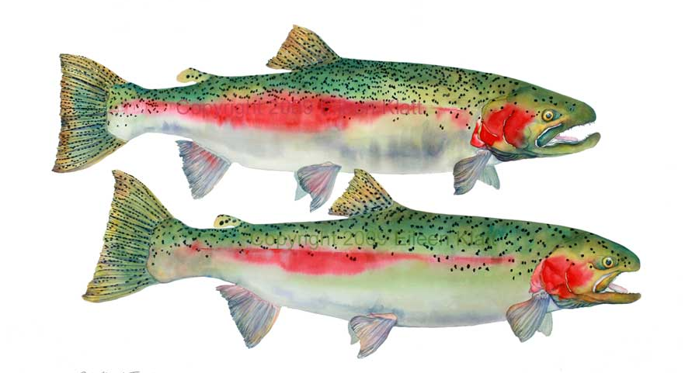
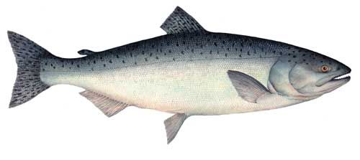
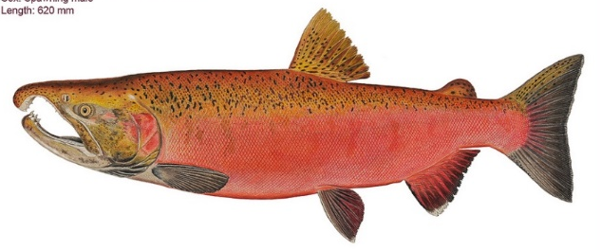
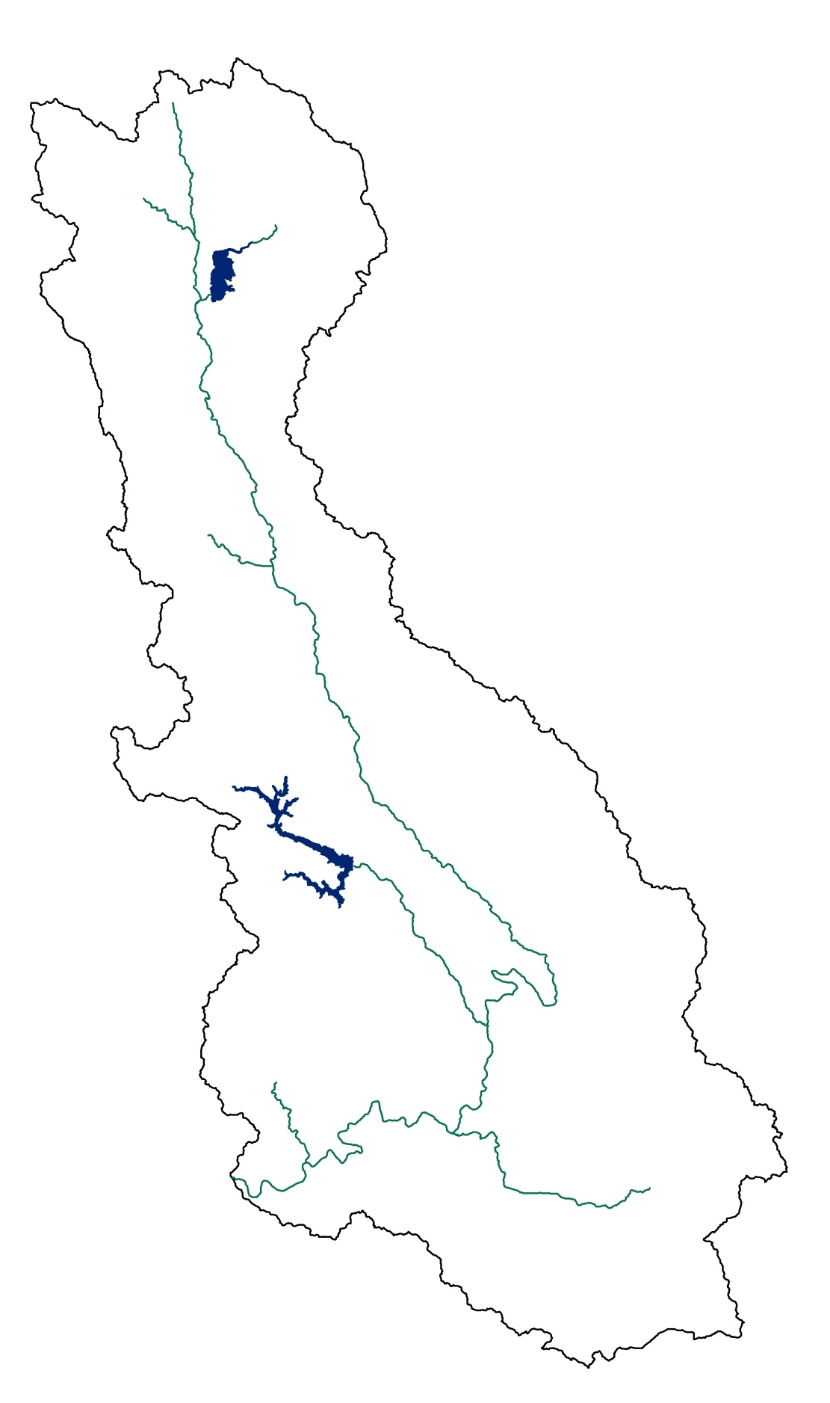
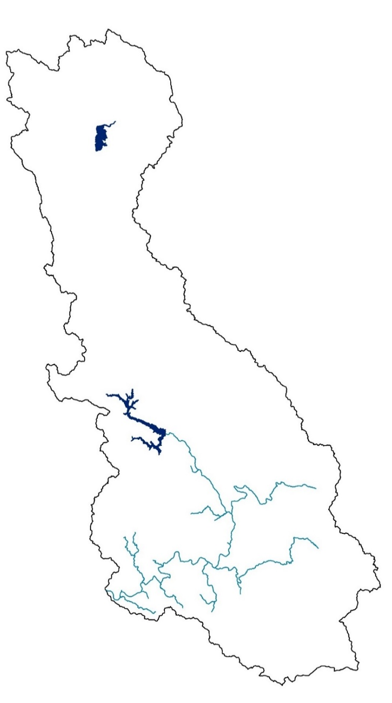
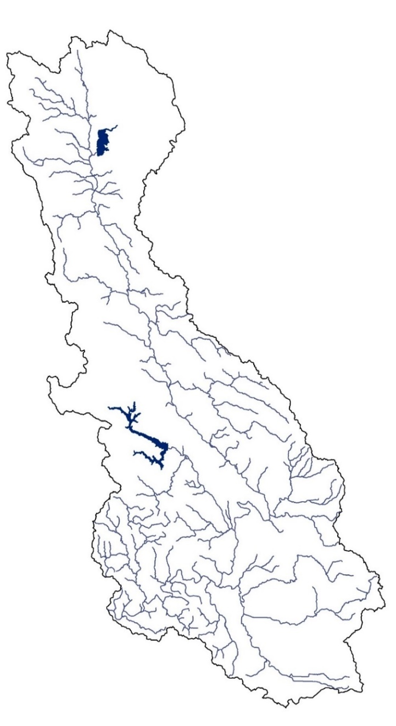
Chinook salmon
Coho salmon
Steelhead trout
Notes:
Chinook salmon (threatened): main stem of the Russian River and large tributaries, adults Sept. to Dec, Juveniles leave for the estuary or ocean in March.
Coho (endangered): tributaries in the southwestern watershed, adults November to January. Juveniles rear in tributaries for 1-4 years, oversummer: cold water rearing.
Steelhead (threatened): widest distribution main stem and many tribs, Adults January to April, rear for 1-4 years

Slide 25
Species | Timing | Habitat Requirements: Channel Slope, Flow Conditions, Complexity of Channel | Colluvial | Bedrock | Confined alluvial | Semiconfined alluvial | Alluvial fan | Dissected alluvium | Unconfined alluvial | Regulated
Adult Migration
Chinook | Sept-Dec | 0-1%; sufficient stream flow and depth
Coho | Nov-Jan | 0-3%; sufficient stream flow and depth
Steelhead | Jan-Apr | 0-4%; sufficient stream flow and depth
Spawning and Egg Incubation
Chinook | Oct-Feb | 0-1%; PR; intragravel flow; high DO; low fines; little scour
Coho | Nov-Mar | 1-3%; PR, FPR; intragravel flow; high DO; low fines; little scour
Steelhead | Jan-May | 1-4%; FPR, PB, SP; intragravel flow; high DO; low fines; little scour
Rearing: Spring-Summer-Fall
Chinook | Dec-May | low velocity margins; floodplain; cover; food supply
Coho | Feb-Dec | perennial flow; large woody debris; cool temps; cover; food supply
Steelhead | Mar-Dec | perennial flow or isolated pools; cool temps; cover; food supply
Rearing: Winter
Chinook | - | N/A
Coho | Dec-Mar | large woody debris; flow refugia: floodplains, alcoves, backwater
Steelhead | Dec-Mar | flow refugia: unembedded substrate, cobble, boulder
Smolt Outmigration
Chinook | Mar-Jun | sufficient flow and depth
Coho | Mar-Jun | sufficient flow and depth
Steelhead | Apr-July | sufficient flow and depth
Consistently satisfy salmonid habitat requirements = black; May satisfy habitat requirements depending on local conditions = grey; Not expected to satisfy habitat requirements = white.
Notes:
Those channel types that are expected to consistently satisfy salmonid habitat requirements are indicated in black; channel types that may satisfy habitat requirements depending on local conditions are indicated in grey; channel types that are not expected to satisfy habitat requirements are white.

Slide 26


In confined and semiconfined alluvial and dissected alluvium channels dry season stream flow and salmonid rearing habitat is affected by:
Bedrock type and permeability
Thickness and width of alluvial deposit
Other factors affecting summer stream flow - channel slope and confinement, timing and amount of rainfall, surface and groundwater diversions, channel entrenchment

Slide 27
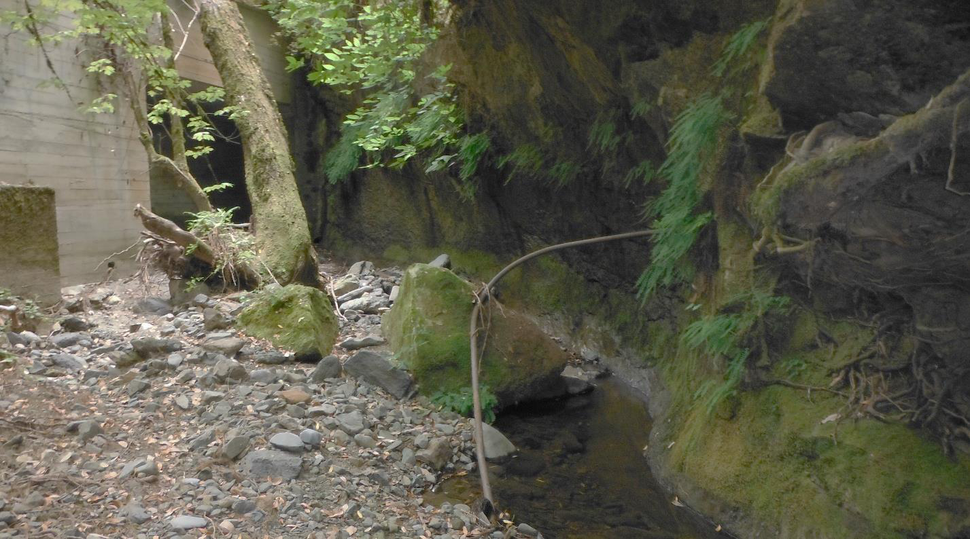
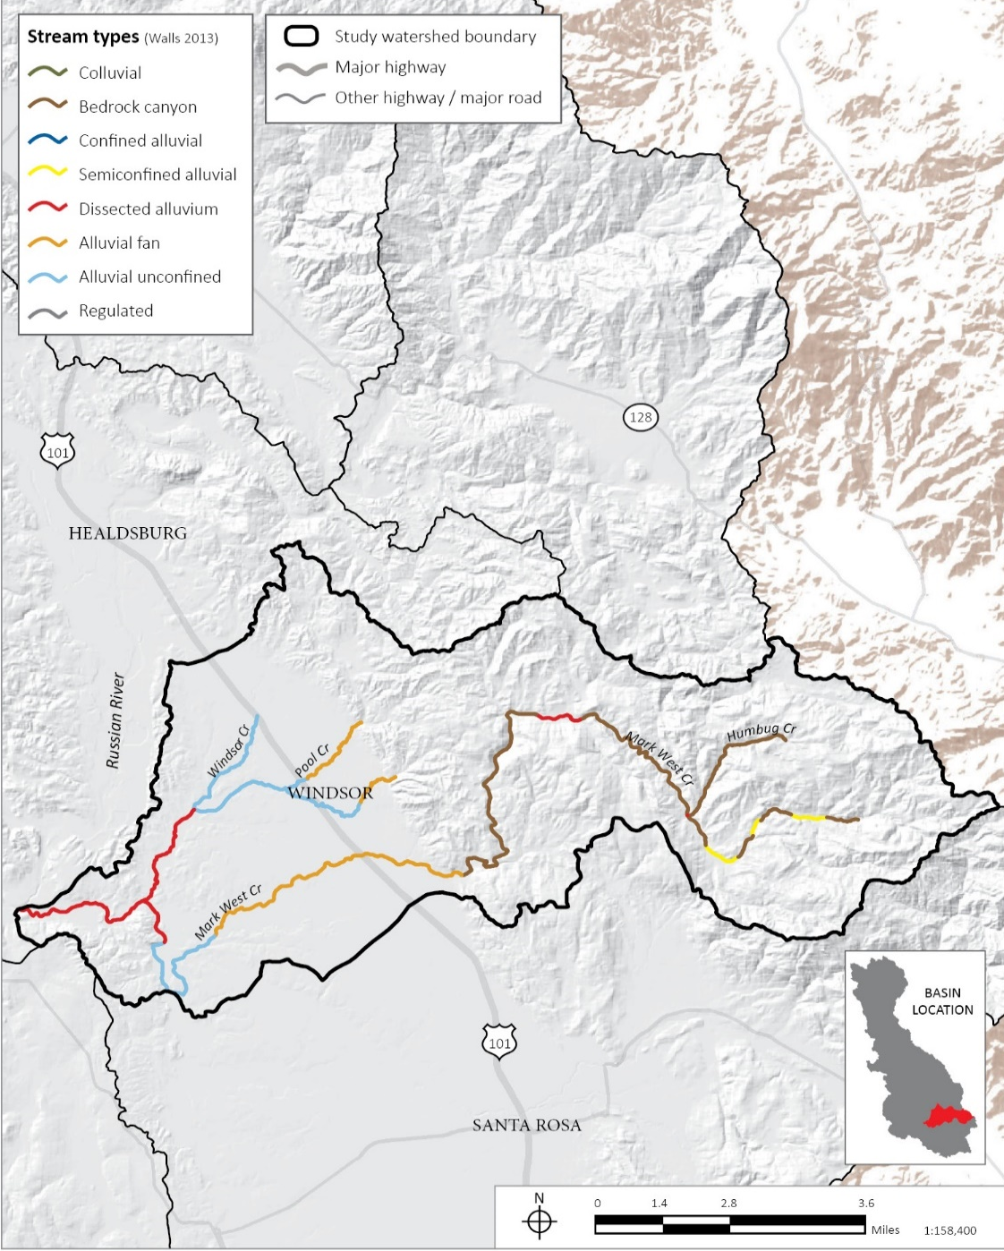
A slow trickle of groundwater into this semiconfined alluvial channel maintains steelhead trout rearing habitat

Slide 28
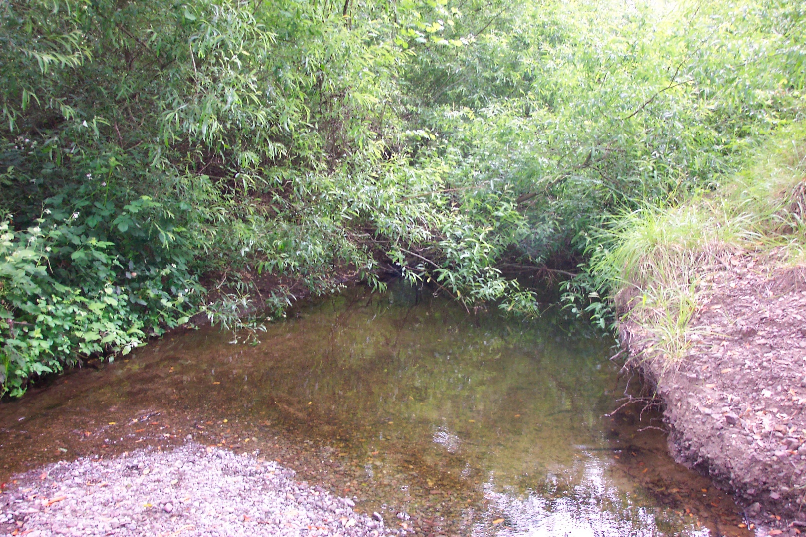
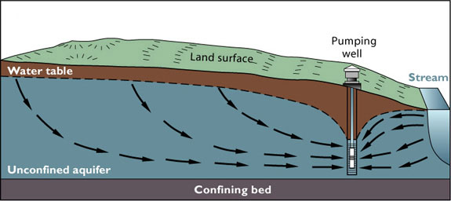
The persistence of summer pools depends upon whether the creek continues to gain groundwater. Small water diversions along tributaries can alter this process especially in dry years

Slide 29
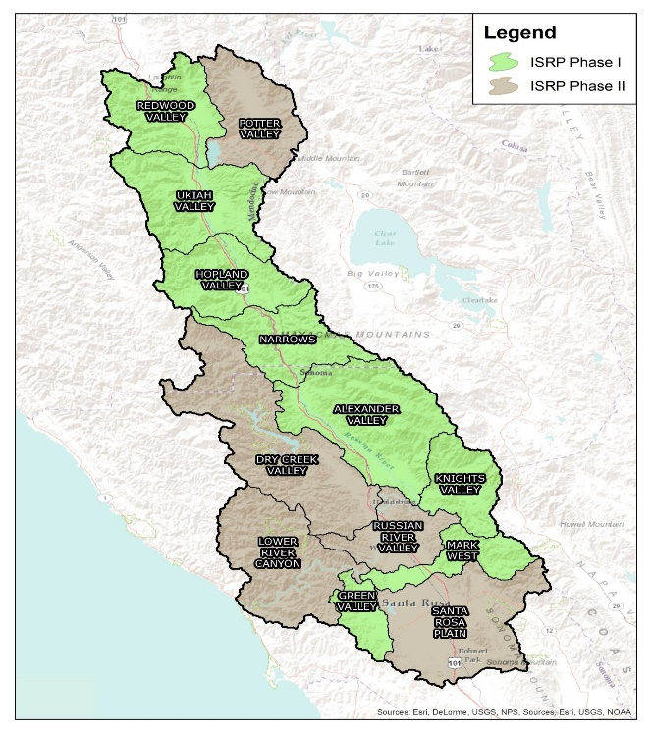
RECOMMENDATIONS
1. A whole system approach is needed and all areas of the
Russian River watershed require the detailed review
completed for eight subareas by this report. The remaining
five subareas should also be evaluated.
2. Prioritized studies to fill major data gaps.
3. Development of economic incentives to change water management.
4. Development of a numerical model of the watershed that uses the recommended monitoring data, simulates surface and groundwater interactions and can be used to evaluate effects of changes in water use and can be used with salmonid data to prioritize restoration actions.
5. Restoration recommendations for each channel type.

Slide 30
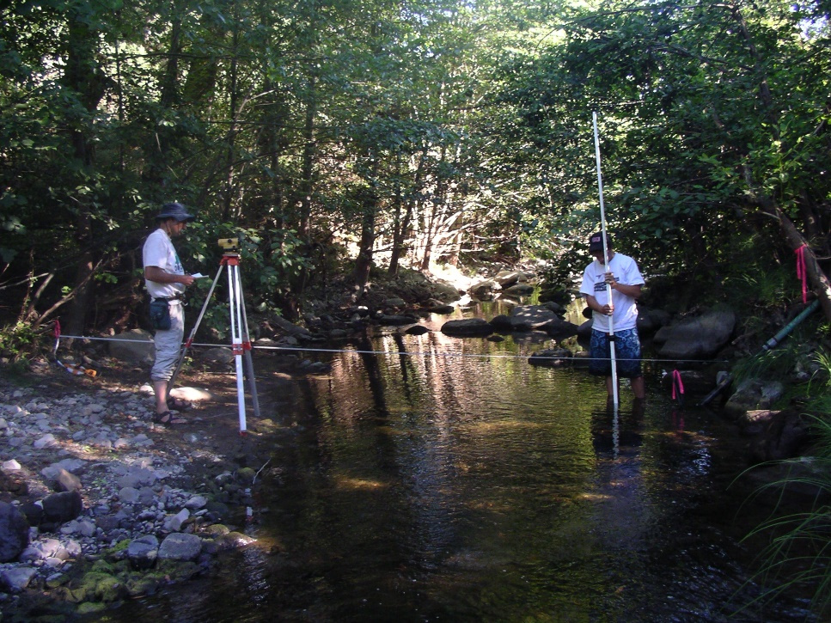
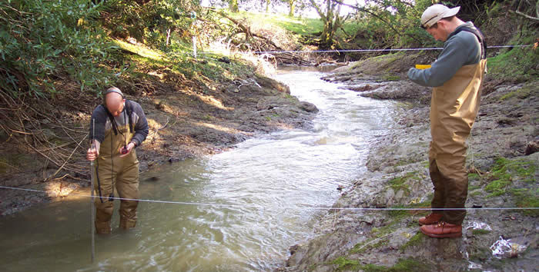
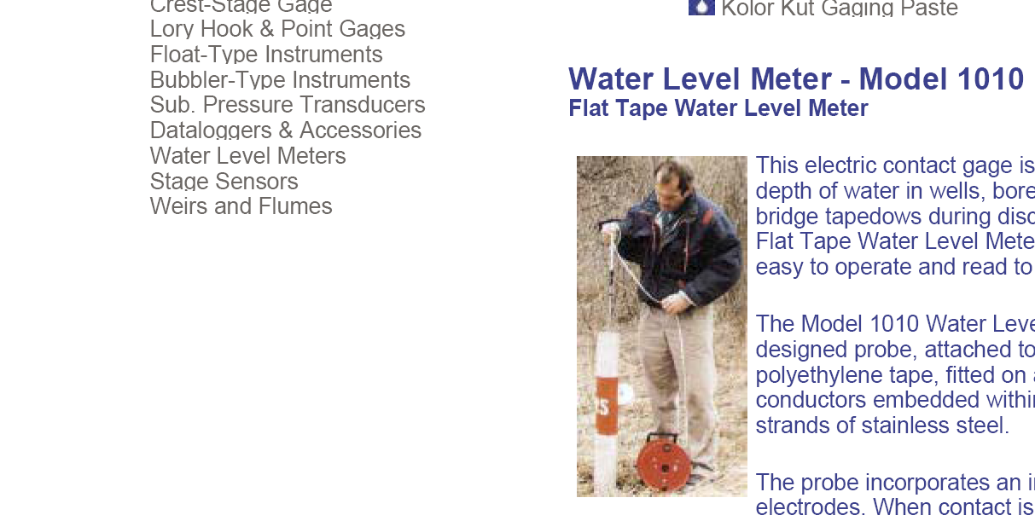
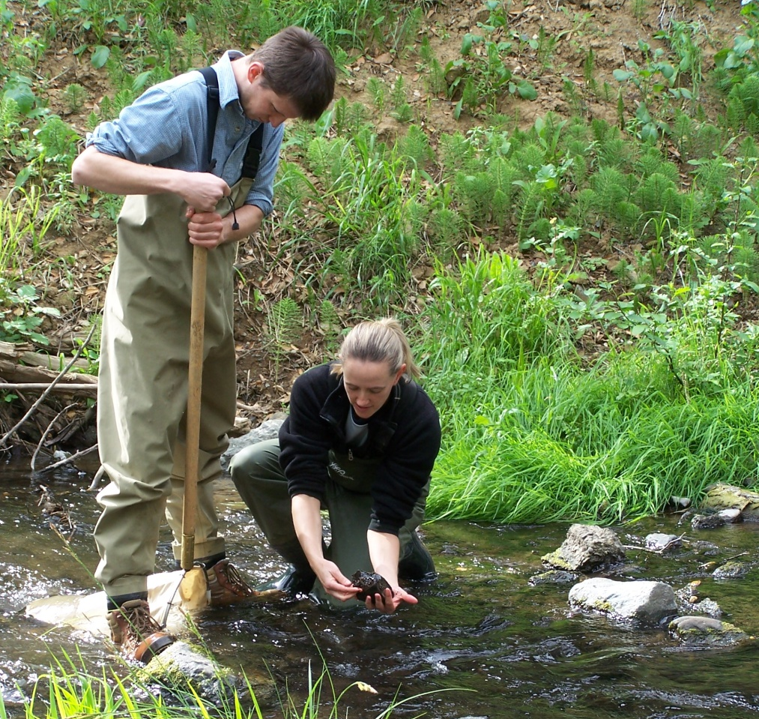
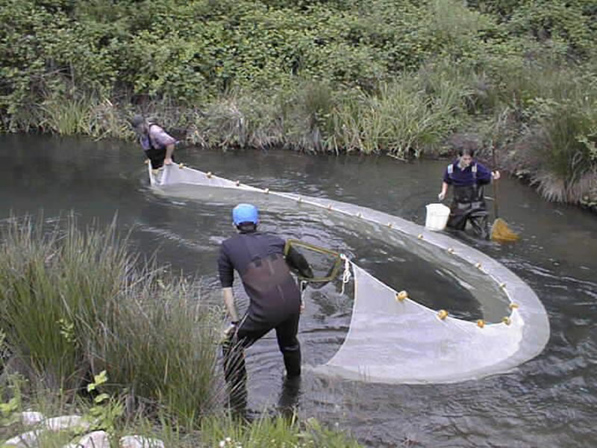
2. Prioritized studies to fill major data gaps
Surveying channel cross-section for stream flow gage
Measuring discharge for stream flow gage
Seining fish
Monitoring well levels
Sampling macroinvertebrates

Slide 31
The ISRP collected and reviewed sources of information on:
Rainfall and air temperature
Geology
Groundwater
Surface water
Geomorphology
Water quality – water temperature
Climate change studies
Water Demand and Use
Aquatic Communities
The ISRP is recommending additional data collection in:
Aquatic communities
Groundwater
Surface Water
Water Use
Plus focused studies in geomorphology, climate change

Slide 32
Aquatic Communities Data Gaps
There is very little comprehensive ecological data on the aquatic communities in the Russian River and its tributaries. Existing studies primarily consist of single-day qualitative habitat surveys of creeks, one-time collections of benthic macro-invertebrates, or juvenile salmonids, often without adequate field data to determine the location of the sampling.
The main stem river has been studied in greater detail with annual spawner studies in certain locations since 2002.
There is no population data and limited recent presence/absence data on steelhead trout in the tributaries outside of several Coho salmon tributaries
Very little data on non-salmonid fishes, amphibians, or invertebrates has been collected.
Species have been studied in isolation. Conservation of anadromous fish populations also requires an understanding of ecological interactions with other species
Groundwater Data Gaps
Continuous groundwater monitoring (elevation, temperature) is lacking in alluvial valleys, confined alluvial, semiconfined alluvial, and dissected alluvium channel types.
For existing wells an inventory of well features, e.g. elevation of first screen, diversion volume and timing is needed
Notes:
The effects of natural and human caused stressors (floods, droughts, water diversions, dams, land use changes, pollution) on aquatic communities cannot be evaluated if there is little to no information on the aquatic community in a particular impacted creek.
Similarly no priorities can be established between tributaries without a clear understanding of the aquatic community in each tributary.

Slide 33
Surface Water Data Gaps
Stream flow gages are primarily on the main stem Russian River with only a few on tributary streams
Due to the high level of variation in the geology and topography of tributary streams, gaging data can not be accurately extrapolated between tributaries
Geomorphology Data Gaps
Uncertainty about dynamics of Russian River main stem channel evolution
How much has the main stem river channel aggraded (built-up) or degraded (downcut) since the last survey was done?
Is the incision process continuing and at what rate?
How are tributary streams in the alluvial valleys adjusting to incision of the main stem?
Climate Change Focused Study
The questions important to answer for future climate change studies include:
What will future water temperatures be in specific tributary locations under various climate change scenarios?
Can we prioritize restoration efforts in tributaries where cold water may be more prevalent?
How will increased future water demands for urban, rural residential and agricultural land use fare under predicted future climate scenarios?
Will there be adequate flows for human uses and fish and aquatic life?

Slide 34
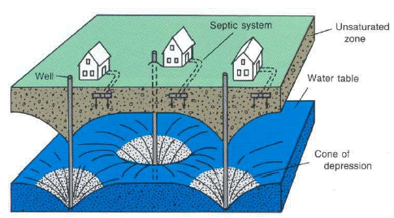
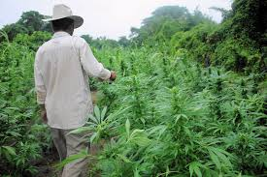
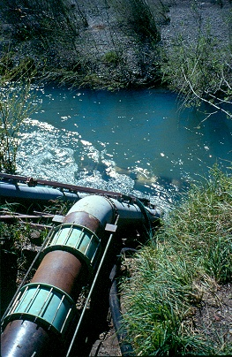




WATER DEMAND

Slide 35
Municipal Water Use
Municipal use by cities for residential and industrial use
within the city boundary is the easiest to quantify.
Summer demand is the greatest.
Groundwater Use
Groundwater use is the most problematic water use category, given that current well use does not involve a water right and there is no reporting of groundwater diversions.
Lack of such data on groundwater use is a challenge in terms of water management options, such as the use of conjunctive management to address seasonal disparities in surface water availability.
The complexity of surface and groundwater interactions in the Russian River basin makes it difficult to quantify the impact of these different types of water use (i.e., surface vs. groundwater) on stream flows.
Sustainable Groundwater Management Act
should improve groundwater measurement

Slide 36

Rural Residential Water Use
Rural residential use is largely unknown, since such use is typically from unmonitored, individual residential wells and surface water diversions.
On the Santa Rosa Plain the USGS estimated that rural non-municipal use of groundwater makes up 82% of total groundwater extraction with 32% going to agriculture and 50% going to rural residential uses.
These studies point to rural residential water use as significant in reducing dry season flow in some tributaries.

Slide 37


Agricultural Water Use
Blue dots indicate locations of small water projects with permits or pending permits as documented in the State Water Resources Control Board database. Most of these are for agricultural crops not including marijuana.

Slide 38
 |  | Amount directly diverted or collected to storage (AF) 2014 | Amount Used (AF) 2014 | Amount directly diverted or collected to storage (AF) 2013 | Amount Used (AF) 2013 | Amount directly diverted or collected to storage (AF) 2012 | Amount Used (AF) 2012 | Amount directly diverted or collected to storage (AF) 2011 | Amount Used (AF) 2011 | Amount directly diverted or collected to storage (AF) 2010 | Amount Used (AF) 2010 | Amount directly diverted or collected to storage (AF) 2009 | Amount Used (AF) 2009
All Water Rights (195 Total) | Number Reported | 102 | 102 | 116 | 116 | 147 | 147 | 150 | 150 | 148 | 148 | 88 | 88
 | % Reported | 52% | 52% | 59% | 59% | 75% | 75% | 77% | 77% | 76% | 76% | 45% | 45%
 | Sum (Acre-Ft) | 4733.2 | 4643.2 | 7378.1 | 9530.7 | 8309.3 | 8249.5 | 8013.9 | 8018.1 | 8519.7 | 8508.4 | 6199.1 | 6175.4
Riparian (95 Total) | Number Reported | 24 | 24 | 36 | 36 | 69 | 69 | 70 | 70 | 67 | 67 | 31 | 31
 | % Reported | 25% | 25% | 38% | 38% | 73% | 73% | 74% | 74% | 71% | 71% | 33% | 33%
 | Sum (Acre-Ft) | 1110.7 | 1093.3 | 1771.1 | 1780.8 | 3132.0 | 3109.5 | 2903.9 | 2906.9 | 3226.3 | 3220.0 | 798.4 | 784.4
Appropriative (100 Total) | Number Reported | 78 | 78 | 80 | 80 | 78 | 78 | 80 | 80 | 81 | 81 | 57 | 57
 | % Reported | 78% | 78% | 80% | 80% | 78% | 78% | 80% | 80% | 81% | 81% | 57% | 57%
 | Sum (Acre-Ft) | 3622.5 | 3549.9 | 5607.0 | 7749.9 | 5177.3 | 5140.0 | 5109.9 | 5111.2 | 5293.4 | 5288.4 | 5400.7 | 5391.1
Water Rights Data
The State Water Resources Control Board regulates and keeps records of surface water rights and some groundwater diversions. The amount of water used is the volume put to a beneficial use and is reported annually. The Table shows reporting data for the Ukiah Valley subarea. Data is missing for many rights with 2011 having the highest reporting rate at 77% of water right holders submitting use reports. Other subareas had equally low reporting rates. Beginning in January 2017, all diverters of 10 AF or more per year have to install and maintain a device that monitors the rate and quantity of diverted water.

Slide 39

Marijuana Water Use
The driest period (June-October) of the year coincides with the highest irrigation demand for marijuana.
Marijuana grows tend to be located in the upper mountainous areas of tributary watersheds where most bedrock channels are located and are the primary rearing habitats for steelhead
There are no estimates of the acreage of marijuana grows in the Russian River. Figure illustrates the density of marijuana grows in the Outlet Creek drainage just north of the Russian River watershed.

Slide 40
3. Development of economic incentives to change water management
Management of water issues within the basin will inevitably involve tradeoffs.
Economic information can provide guidance on the nature and efficacy of tradeoffs by identifying least cost alternatives to meet a given goal or objective.
Changing water user behavior can be enhanced through use of economic incentives
Within the Russian River basin subsidies may be effective in some settings, such as construction of off-stream water storage facilities for use in frost protection or to fund in-stream flow and riparian habitat improvements in the tributaries.
An economic mechanism that is aimed at improving the efficiency of water use is the creation of a water market. Water markets have been used widely to facilitate alternative water allocations in the arid west.
Water markets have the advantage of being voluntarily exchanges between sellers of water and potential buyers, usually a public agency.

Slide 41

4. Development of a numerical model of the watershed that uses the recommended monitoring data, simulates surface and groundwater interactions and can be used to evaluate effects of changes in water use and can be used with salmonid data to prioritize restoration actions
The lack of stream flow and groundwater monitoring data, water use data as well as the lack of salmonid population and distribution data severely limits identification of priority streams for salmonids and needed water management actions. For example, the significance of a dry channel, or intermittent pools, cannot be determined if we do not know what areas of the tributary salmonids use for rearing. If the one reach of good rearing habitat dries up, this would be a significant problem. But if that reach is a migration corridor where water is only needed in the winter and spring, a summer dry channel is not a problem for salmonids.
In California’s Mediterranean climate seasonally-dry channels are a natural part of the watershed, and not necessarily the result of water diversions. The channel typology developed by the ISRP provides a system to define where summer stream flows are likely to occur and where they are not likely to occur. A bedrock channel is likely to have flow in the summer, while an alluvial fan, or valley unconfined alluvial channel, are likely to be dry. The suggested stream flow and groundwater monitoring of confined alluvial, semiconfined alluvial, dissected alluvium channels in various tributaries can further define summer time flow locations and allow for the effect of water diversions to be determined.
Notes:
As this talk is focused on results from GSFLOW, I would like to provide a quick overview of what the model and its capabilities. GSFLOW was developed in 2008 by the USGS by integrated the watershed runoff model PRMS and the groundwater flow model MODFLOW-NWT. It is typically used for evaluating water resources problems and here we use it for researching drought, watershed runoff processes, and for flood risk.

Slide 42


Slide 43

5. Restoration recommendations for each channel type
This is a list of potential measures. A specific application will require study, analysis and design.

Slide 44




Restoration Techniques: Removal of Fish Migration Barriers
Culvert replacement with railcar bridge
Baffles in culvert
Removal of on-stream dam

Slide 45




Restoration Techniques: Revegetation

Slide 46





Restoration Techniques: Placement of Large Wood in Streams
Artificial instream structures are not recommended.

Slide 47




Restoration Techniques: Gravel Augmentation below Dams
Notes:
Not mentioned in report or summary???!!!!

Slide 48
Restoration Techniques: Benching along Incised Reaches
Use excavated material for sediment supply to channel
Referred to as “bank setbacks” below

Slide 49



Water Management
Construction of off-stream ponds with winter diversions
NMFS compliant fish screens on all diversions
Along tributaries screen wells deeper to avoid impacts on low water flows.

Slide 50


Colluvial
< 6 months continuous flow
Salmonid use | Typical developments | Restoration recommendations
Low to no use Aquatic invertebrates and amphibians | Housing Hillside vineyards On-stream reservoirs | Residential stormwater BMPs (+infiltration) Riparian corridor vegetation Keep water moving downstream and downslope cool and clear

Slide 51



Bedrock
generally perennial flow
Salmonid use | Typical developments | Restoration recommendations
Spawning Egg incubation Rearing Adult and smolt migration | Reservoirs Diversions Near-channel wells Illegal diversions for marijuana production | Protect Convert summer direct diversions to winter only with storage Revegetate riparian corridor Remove migration barriers Large wood

Slide 52



Confined alluvial
6-12 months of flow
Salmonid use | Typical developments | Restoration recommendations
Spawning Egg incubation Rearing Adult and smolt migration | On-stream reservoirs Diversions into off-stream reservoirs Near-channel wells Direct diversions | Along tributaries, construct/screen wells to avoid impacts on low water Convert summer direct diversions to winter only with storage Revegetate riparian corridor Remove migration barriers Large wood

Slide 53



Semiconfined alluvial
10-12 months of flow
Salmonid use | Typical developments | Restoration recommendations
Spawning Egg incubation Rearing Adult and smolt migration | Wells in floodplain Floodplain development Direct diversions Diversion into off stream storage | Use numerical model to manage wells and diversions Revegetate riparian corridor Remove migration barriers Large wood Bank setbacks May need grade control if incised

Slide 54


Dissected alluvium
8-12 months of flow
Salmonid use | Typical developments | Restoration recommendations
Spawning Egg incubation Rearing Adult and smolt migration | On-stream reservoirs Direct diversions into off-stream reservoirs Wells | Use numerical model to manage wells and diversions Revegetate riparian corridor Remove migration barriers Large wood Bank setbacks May need grade control if incised

Slide 55



Alluvial fan
5-9 months of flow
Salmonid use | Typical developments | Restoration recommendations
Adult and smolt migration | Wells Direct diversions into off stream reservoirs | Use numerical model to assess effects of main stem river flow stage on water levels Revegetate with oak savannah Remove migration barriers

Slide 56


Unconfined alluvial
3-6 months of flow
Salmonid use | Typical developments | Restoration recommendations
Adult and smolt migration Spawning and rearing in limited locations | Gravel mining Channelization/incision Flood plain development On-stream reservoirs Direct diversion into off-stream reservoirs Wells | Evaluate effects of developments using numerical model Revegetate riparian corridor Remove migration barriers. Large wood Bank setbacks Grade control

Slide 57


Regulated Continuous flow
Salmonid use | Developments | Restoration recommendations
Adult and smolt migration Spawning and rearing in limited locations | Large reservoirs Gravel mining Channelization Floodplain development Wells | Just below Coyote Dam and the Narrows Manage for salmonids Use model to evaluate surface and groundwater interactions Just below Coyote Dam Widen river channel and complex riparian corridor through work with willing landowners Gravel augmentation
 |  | Remaining reaches of the Russian River Winter and spring spawning and rearing for Chinook Native warmwater species Minimize gravel mining in river channel Improve riparian and aquatic habitats

